Slide 1
The Whoosh: Innovative Data Exchange to Save Time and Improve Care in Hawaii, Boston EMA, and Riker's Island
Alison Jordan, Senior Director, Transition Reentry & Continuity Services, New York Health and Hospitals Corporation
Ray Higa, Planner, Hawaii Department of Health
Eric Thai, Interim Director, HIV/AIDS Services Division, Boston Public Health Commission
Jesse Thomas, RDE System Support Group, LLC
Notes:
Required slide. Please complete

Slide 2
Hello!
  Jesse Thomas, Project Director
  Serving public health for over 18 years, HIV/AIDS programs 12+ years (HRSA, CDC, HUD, NIH)
  RDE Systems
    Founded by head technologist teaching at Rutgers University in MPA program
    Human factors slant: People First!
    “A most unique IT company. Mission-driven.”
  Technical Manager for over 12 HRSA Special Projects of National Significance

Slide 3
Disclosures
New York Health and Hospitals Corporation, Hawaii Department of Health and Boston Public Health Commission have no financial interest to disclose.
Jesse Thomas works as Project Director for RDE System Support Group, LLC.
This continuing education activity is managed and accredited by Professional Education Services Group in cooperation with HSRA and LRG. PESG, HSRA, LRG and all accrediting organization do not support or endorse any product or service mentioned in this activity.
PESG, HRSA, and LRG staff has no financial interest to disclose.
Notes:
Required slide. Please complete section under Presenter

Slide 4
Learning Objectives
At the conclusion of this activity, the participant will be able to:
Recognize how a paradigm of health information exchange can free up time which is more constructively spent on client care and quality improvement.
Describe how to adopt and adapt strategies and tools to implement web-based resources to achieve federal compliance and improved quality management.
Identify, analyze and evaluate the pitfalls and benefits of implementing health information exchange, including the adoption of federal Office of that National Coordinator (ONC) standards.

Slide 5
Obtaining CME/CE Credit
If you would like to receive continuing education credit for this activity, please visit:
http://ryanwhite.cds.pesgce.com
Notes:
Required slide.

Slide 6
Who are you?

Slide 7
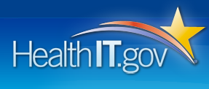
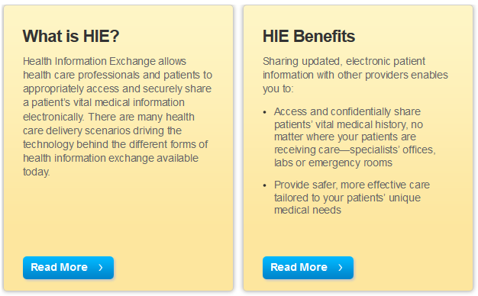

Slide 8
Share it!
&
Use it!

Slide 9
Three Stories

Slide 10




Slide 11


Slide 12




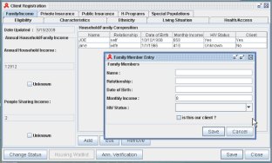
The Old Way
Manual
Data Entry
Manual
Data Entry
Manual
Data Entry
Reggie
Certified
EHR
For:
Practice
Management
and EMR
For:
Part B
Billing and
Reporting
For:
Part C
RSR
Reporting

Slide 13









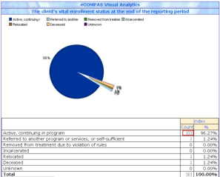


eCOMPAS Data
Import Engine
Certified
EHR
One-Click
Transfer
Review Imported Data
Resolve Data Conflicts
Import Records
eCOMPAS
Visual RSR
One Click Visual RSR
Quality Control Data
Generate Client Level Data File
Upload to
HRSA

Slide 14

Waikiki Health Data Import

Slide 15



Slide 16
Launch!
Smooth launch on-time
Imported 9+ years of Dental Data
e2Boston is currently used by 42 providers
RSR-Compliant
Data Import + Data Converter Module Support for 220 users
Holds over 13,250+ client records.
Holds over 281,800+ service records.
Manages 6+ million pieces of client data.

Slide 17
Importance of Stakeholder Engagement and Support

Slide 18
Proactive Courtesy Calls and Evaluation
  Any problems or barriers with using the system?
  To what degree is the system saving you time?
  To what degree is the system reporting effective for you?
  How is technical assistance and support for you?
  If not a “10”, what can we do to make it a “10”?
  “The fact that someone calls me to make sure that all is well and to see if I have any ideas is just great.”

Slide 19
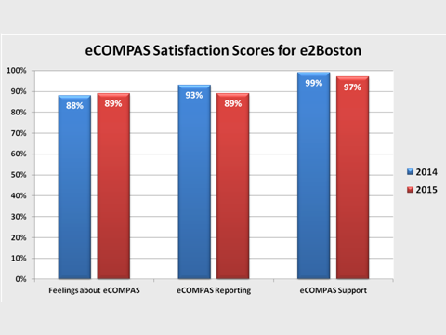

Slide 22
Standards, Tools, TA:
RSR+
&
The Data Converter

Slide 23



Security and Confidentiality
  Advanced Security Module (LKMv2)
  Ethical Hacking / Application Scanning
  Network Vulnerability Scanning
  Point-to-point channel encryption (SSL)
  Strong passwords with 90-day forced expirations
  Role-based security
  Audit Trail
  Access Logging
  IP Address Logging
  Multiple Firewalls (Stateful inspection)
  Encrypted offsite backups
  Continuous Security Updates
  OWASP Security Principles and Code Review
  CISSP with ISSAP and ISSMP concentrations
  Secure Coding Practices and Policies and Procedures
  BAA
  Security Audits

Slide 24
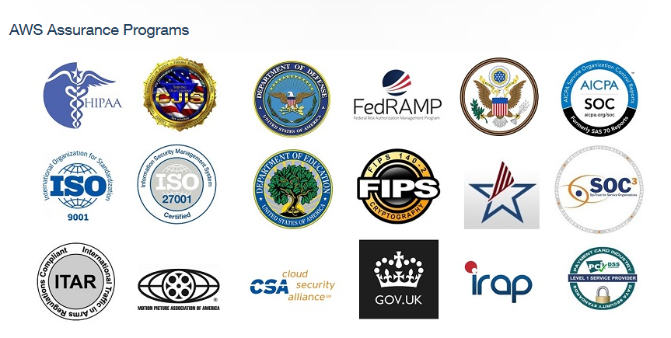
Secure GovCloud – FedRAMP

Slide 25
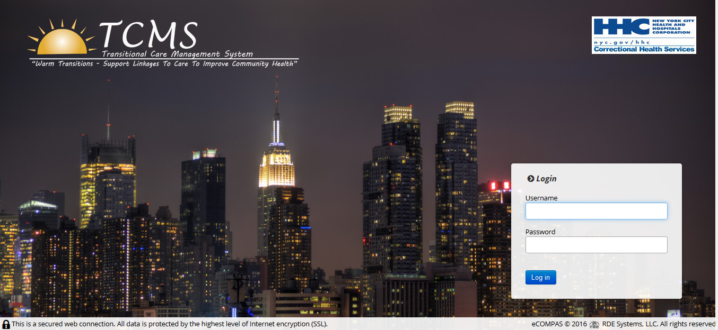
RSR+
&
The Data Converter

Slide 27
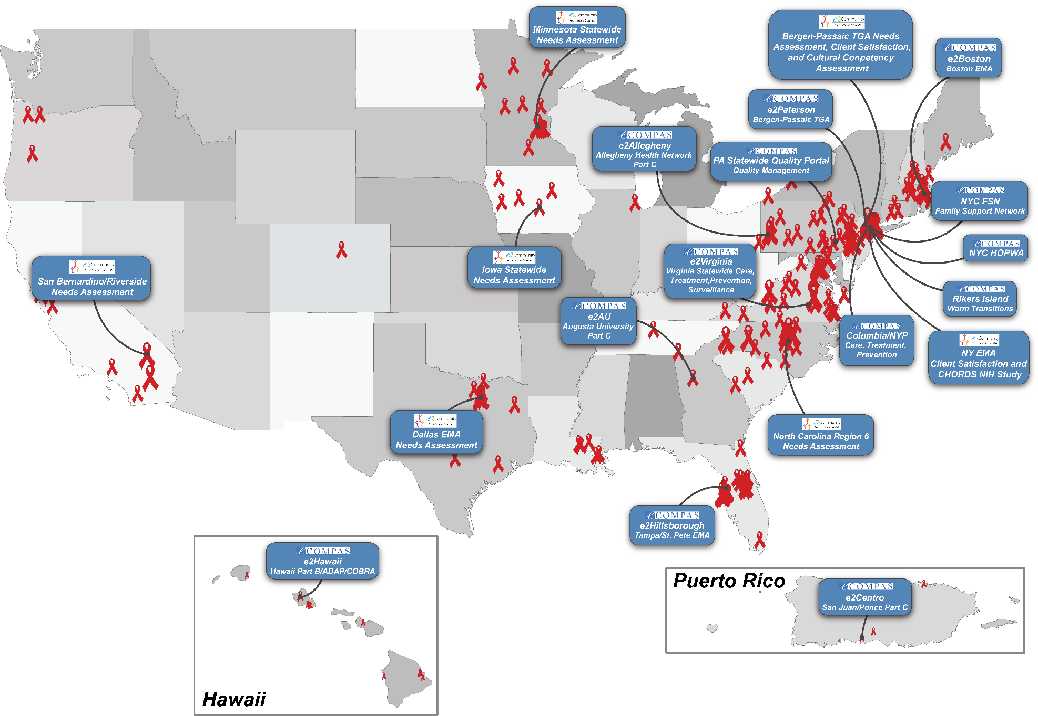

Slide 28

700+ agencies

Slide 29
$400+ million funding managed

Slide 30
27,000+ users

Slide 31
200,000+ patients / clients

Slide 32
132+ million provider data points exchanged

Slide 33
218,000+ hours saved

Slide 34
“For every dollar spent on this initiative, ten dollars has been saved in the healthcare system”

Slide 35
Higher-quality, more coordinated care
Better data, less stressed users
Strengthened plans and grants
Community VL suppression

Slide 36
What Broad Components Should We Consider When Implementing Health Information Technology such as HIE?

Slide 37




Strategy
Process
People
Technology

Slide 38



What affects what?
Strategy
People
Process
Technology
Everything affects everything!

Slide 39
What Are the Main Stages of
the HIT Lifecycle?

Slide 40










Slide 41



Slide 42


Slide 43


Slide 44
A Simple, Integrated Framework for HIT Implementation
Strategy
People
Process
Technology

Slide 45
Lessons
Partnership paradigm
Think win-win-win
Role of IT Departments and Vendors vs Program
Seek out or build standards
Stakeholder engagement, TA, & Support
Security is paramount
Whatever it takes attitude. Choose partners wisely

Slide 46

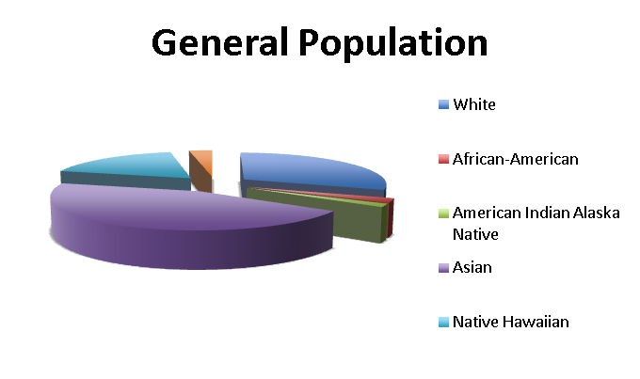
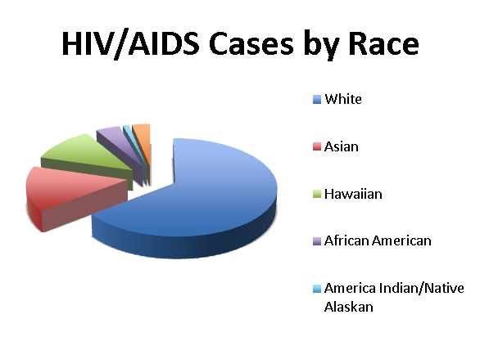
Population 1.42 million

Slide 47
Hawaii HIE and Use of Data
e2Hawaii Ryan White HIE
Part C EMR (Waikiki Health) ←→ Part B HIE
ADAP
Secure Messaging
Visual Reporting and Proactive Alerts & Reminders

Slide 48
Hawaii HIE and Use of Data
e2Hawaii Ryan White HIE
Part C EMR (Waikiki Health) ←→ Part B HIE
ADAP
Secure Messaging
Visual Reporting and Proactive Alerts & Reminders

Slide 49
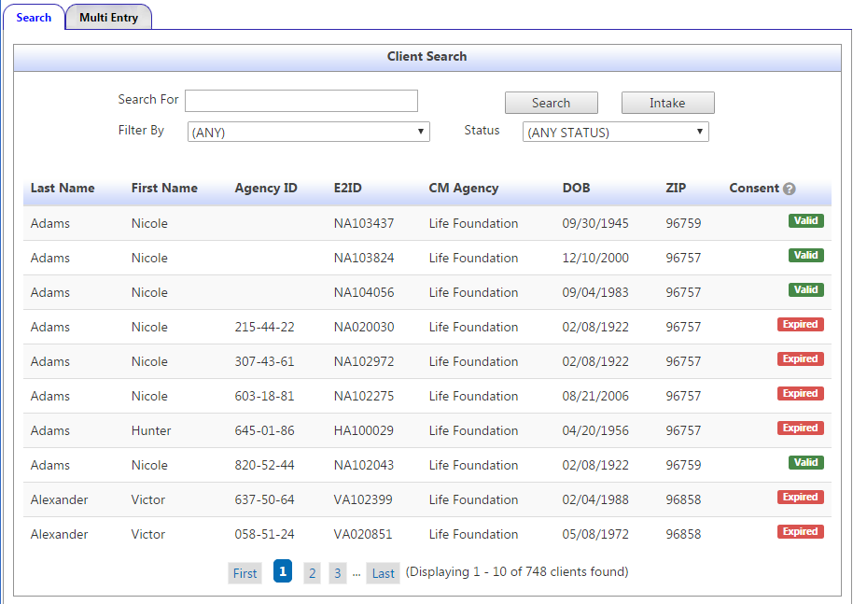
Consent Status on Search Screen

Slide 50
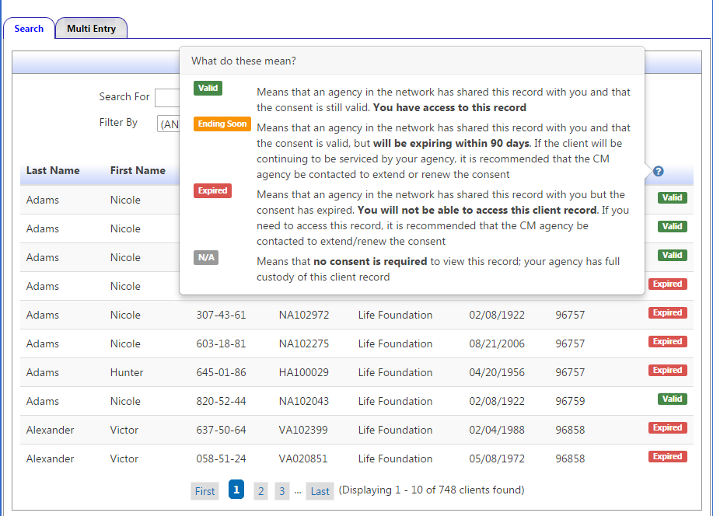
Consent Status on Search Screen

Slide 51
402,343 Progress Notes

Slide 52
306 million data points

Slide 53
5.5+ million data elements shared

Slide 54
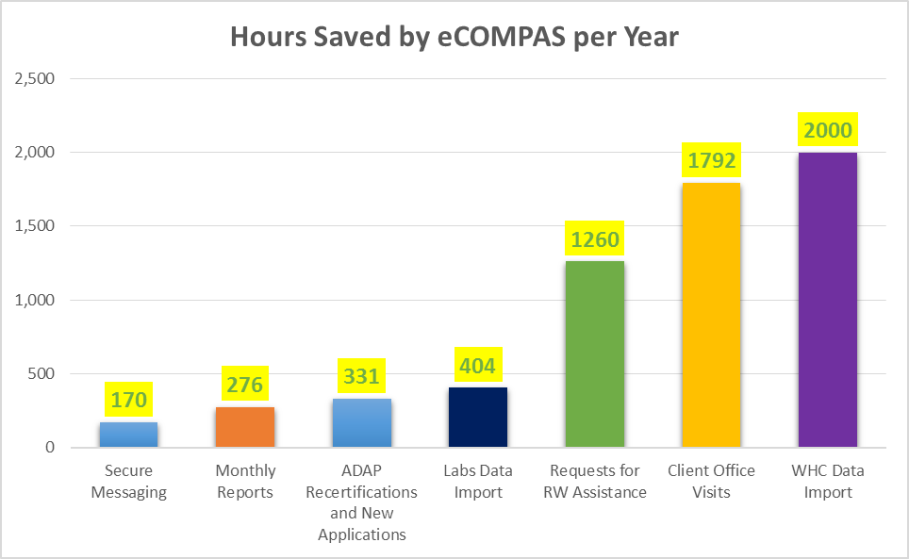
e2Hawaii|Time Savings
Total of 6,063 Hours Saved by e2Hawaii Each Year

Slide 55
Hawaii HIE and Use of Data
e2Hawaii Ryan White HIE
Part C EMR (Waikiki Health) ←→ Part B HIE
ADAP
Secure Messaging
Visual Reporting and Proactive Alerts & Reminders

Slide 56
Waikiki Health Data Import
300,000+ data elements

Slide 57
e2Hawaii|Time Savings
Total of 6,063 Hours Saved by e2Hawaii Each Year

Slide 58
Hawaii HIE and Use of Data
e2Hawaii Ryan White HIE
Part C EMR (Waikiki Health) ←→ Part B HIE
ADAP
Secure Messaging
Visual Reporting and Proactive Alerts & Reminders

Slide 59
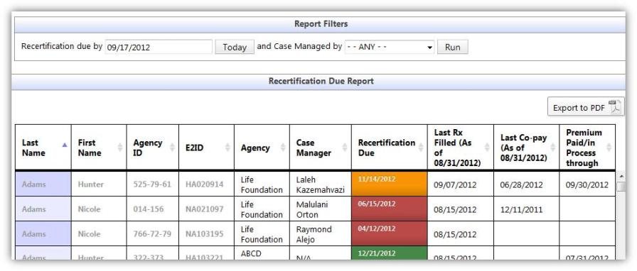
Recertification Due Report

Slide 60
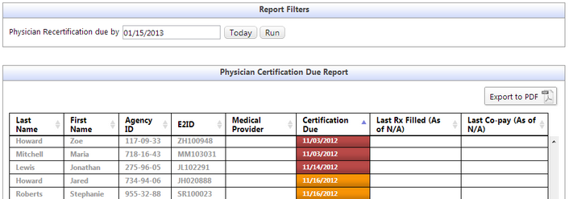
Physician Certification Due Report

Slide 61
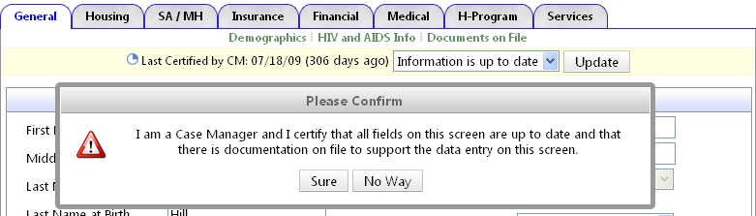
Client Recertification Process
Streamlined H-Program Application
  Client Certification

Slide 62
Time to Complete each ADAP Recertification
161% Improvement
Prior System Average: 47 mins
e2 Average: 18 mins
Time Savings: 29 mins

Slide 63
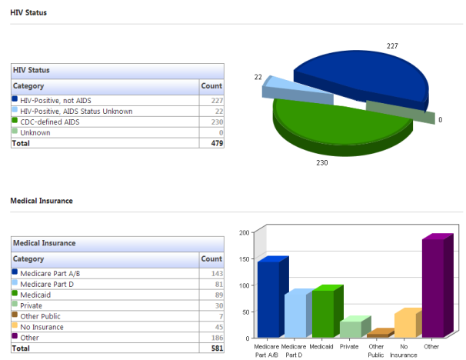
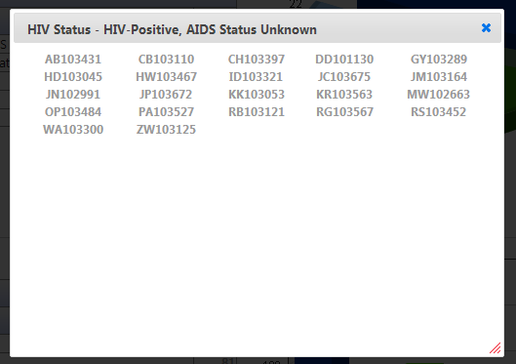
Visual ADAP Drug Report
Aggregate Report – Graphical View

Slide 64
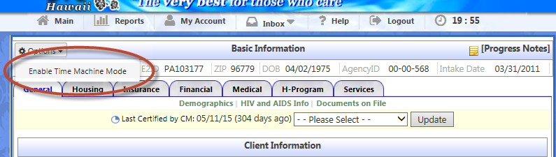
Visual ADAP Drug Report
“Time Machine” Switch Feature
Update data for a past reporting period
Keep past and present data separate
Helps reporting more accurate data to HRSA

Slide 65
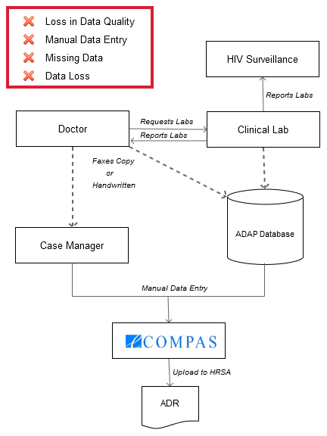
Labs Data Import – the Old Way

Slide 66
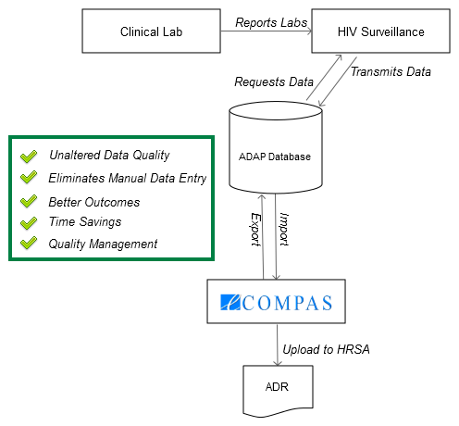
Labs Data Import – the New Way

Slide 67
Labs Data Import
153,384 Data Elements Imported & Shared

Slide 68
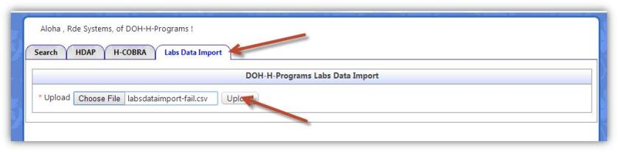

Slide 69
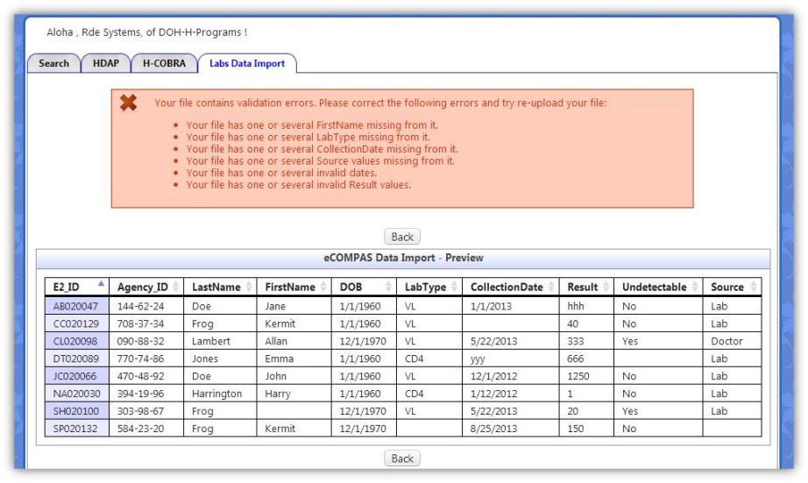

Slide 70
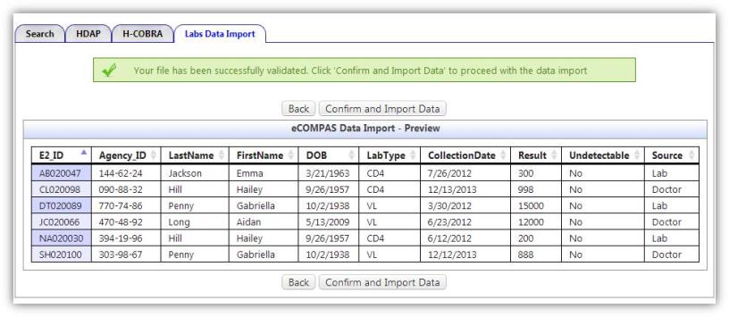

Slide 71
Labs Data Import
Old Way
New Way
Manual Data Entry
Faxed copies of lab work
Handwritten lab reports
Data Import of Labs from Surveillance
No Faxes or handwritten lab reports
No Data Loss
Impact
High Data Quality
Eliminates Data Entry
Better Outcomes
Time Savings
Quality Management

Slide 72
e2Hawaii|Time Savings
Total of 6,063 Hours Saved by e2Hawaii Each Year

Slide 73
Hawaii HIE and Use of Data
e2Hawaii Ryan White HIE
Part C EMR (Waikiki Health) ←→ Part B HIE
ADAP
Secure Messaging
Visual Reporting and Proactive Alerts & Reminders

Slide 74
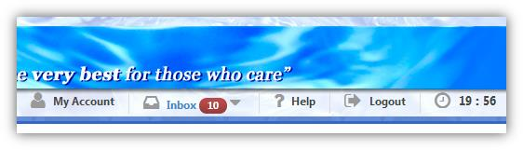
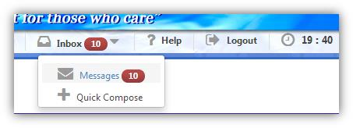
Secure Messaging
Feature: Smart Real-time notifications

Slide 75
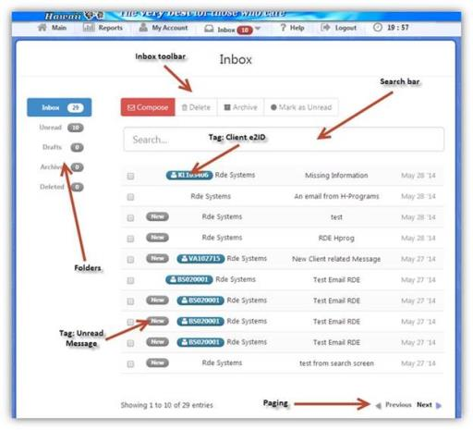
Secure Messaging
Feature: User Inbox

Slide 76
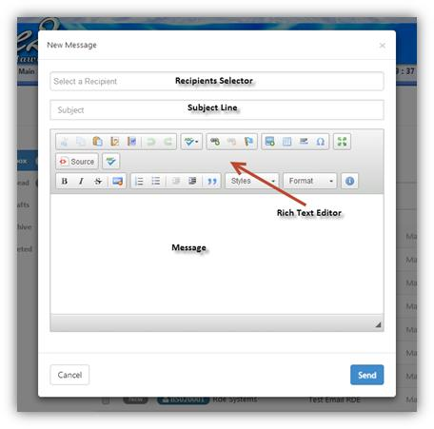
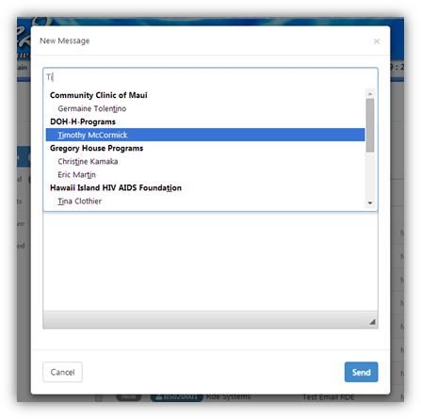
Secure Messaging
Feature: Compose New Secure Message with Autocomplete

Slide 77
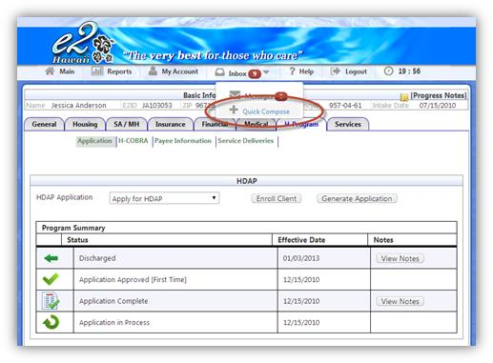
Secure Messaging
Feature: Quick Compose

Slide 78
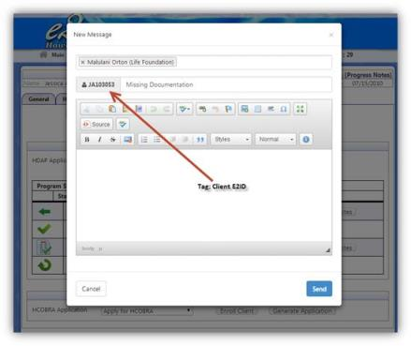

Secure Messaging
Feature: Smart Client Tagging

Slide 79
Secure Messaging

Slide 80
Secure Messaging
5,000+ Messages Sent / Year

Slide 81
Secure Messaging
Old Way
New Way
Phone Calls to Follow-Up
Faxes
External, Insecure Email
Risk of PHI leak
Informal requests & tracking
Send a Secure Message
No more phone calls & faxes
Keep Track of requests and follow-ups
Inter-agency communication
Impact
More Streamlined Care Coordination
More Secure Communications
Time savings
Faster response time and care

Slide 82
e2Hawaii|Time Savings
Total of 6,063 Hours Saved by e2Hawaii Each Year

Slide 83
Hawaii HIE and Use of Data
e2Hawaii Ryan White HIE
Part C EMR (Waikiki Health) ←→ Part B HIE
ADAP
Secure Messaging
Visual Reporting and Proactive Alerts & Reminders

Slide 84
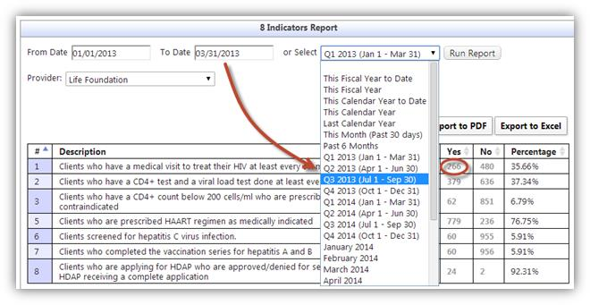
8 Indicators Report

Slide 85
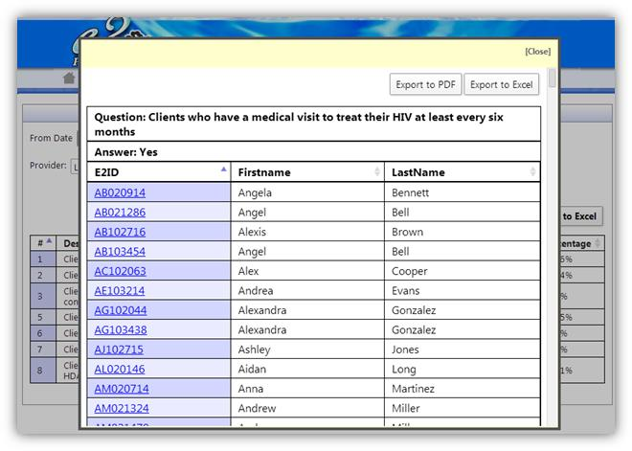
8 Indicators Report

Slide 86
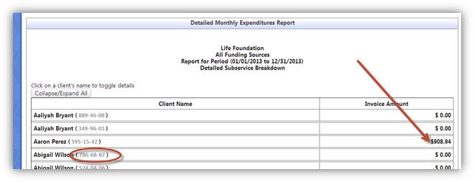
Expenditures Report

Slide 87
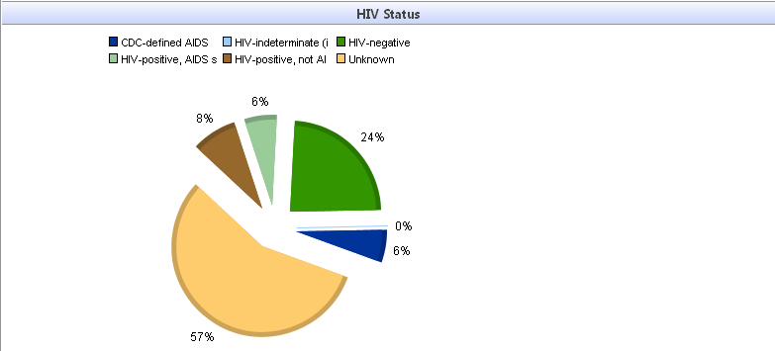
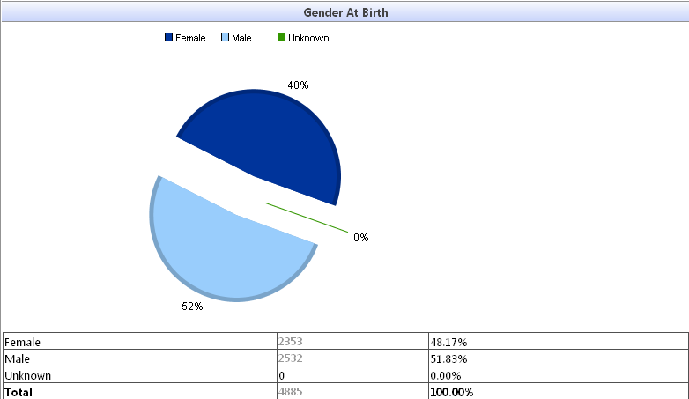
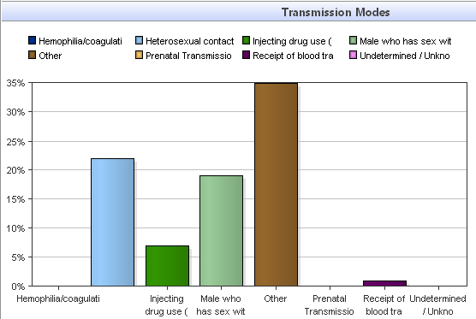
Visual Analytics: From data to action
Visual Analytics

Slide 88
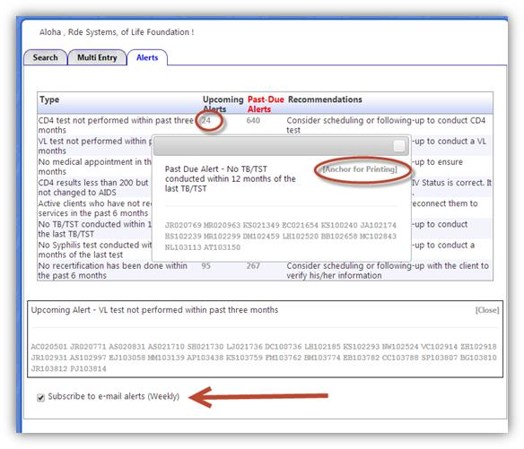
Proactive Alerts & Reminders

Slide 89
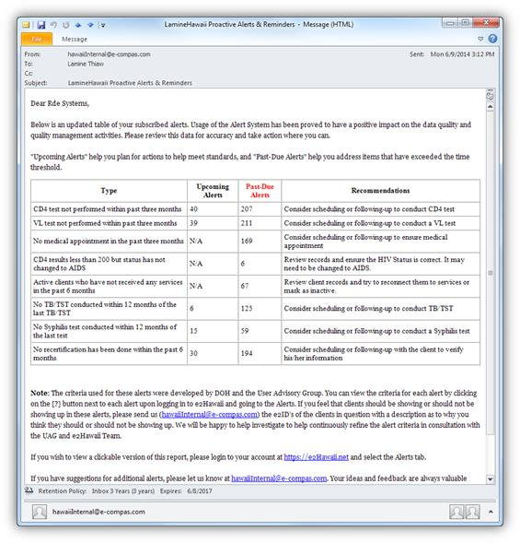
Proactive Alerts & Reminders

Slide 90
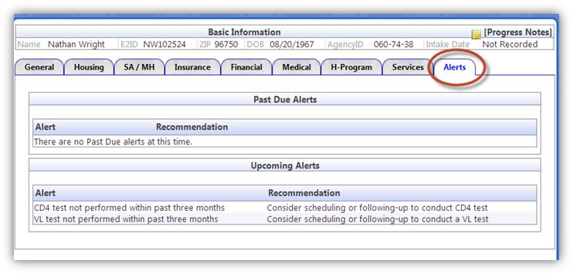
Proactive Alerts & Reminders

Slide 91
Wrap Up: Hawaii HIE and Use of Data
Share it! e2Hawaii Ryan White Cross-Part HIE has a profound impact on care coordination, time savings, and data quality.
The e2Hawaii Waikiki Health story demonstrates key leadership and partnership lessons in being resourceful and dedicated.
Secure Messaging improves productivity, responsiveness, and reduces staff interruptions
Use it! Visual Reporting and Proactive Alerts & Reminders increases data use and reduces the time from data to action.
ADAP, supported by SPNS, produced innovative recertification, eligibility and data exchange. Perfect learning laboratory.

Slide 92

How the Boston Public Health Commission created a client level data system that providers actually use
August 24, 2016
HIV/AIDS Services Division
Infectious Disease Bureau
Boston Public Health Commission
Notes:
Required slide. Please complete

Slide 93
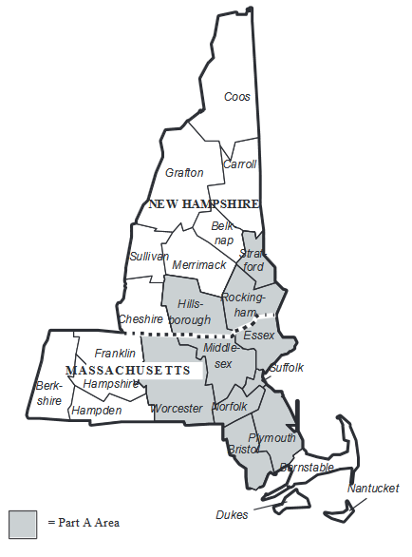
Jurisdictional Profile
The Boston EMA is a 10-county region, comprising 7 counties in MA and 3 counties in NH.
The Boston EMA Planning Council is the community planning body, which prioritizes and allocates funds to service categories.

Slide 94
Jurisdictional Profile
Boston Public Health Commission (BPHC) is designated as the Part A recipient.
The FY 2016 Award for the Boston EMA was $14.6M.
BPHC funds 34 direct service providers, including 54 programs.

Slide 95
Central themes in the BPHC experience prior to moving to a cloud-based system
Maintaining an aging data system
General lack of progress to modernize the infrastructure needed to collect the ever-expanding amount of RWHAP data
Addressing the needs of numerous stakeholder groups in order to build an optimal user experience for all participants
Considering scalability and flexibility for data projects during initial implementation vs. the entire lifespan of a data system

Slide 96
“A data system held together by scotch tape.”
BPHC previously had a custom-built database that could not be modified.
Agencies submitted client demographic & service utilization via paper forms and data entry staff manually entered the data.
This system could not generate the RSR XML file. In the first RSR year, BPHC had to use T-REX to help providers submit.

Slide 97
BPHC needed a solution…fast!
The original vision was to build a networked system that allowed BPHC to also connect with MA Part B data, creating one universal system to report all RW data.
Failure of many data system projects is not knowing what you want, how much you can afford, and how long it takes to get the product out on the street.
To avoid repeating mistakes from the past, the solution must be a commercially off-the-shelf product that allowed for customizability, but had a strong core system.

Slide 98
How do you maintain control over the development process?
BPHC worked collaboratively with the vendor to design a user-friendly interface and reports that reflect the needs of program staff.
This requires recipients to also work collaboratively within their organization, such as with IT/IS departments.
Consider dividing up the labor within the development process into programmatic (e.g. data dictionary) vs. IT/IS (e.g. security) buckets in order to promote a speedy implementation.

Slide 99
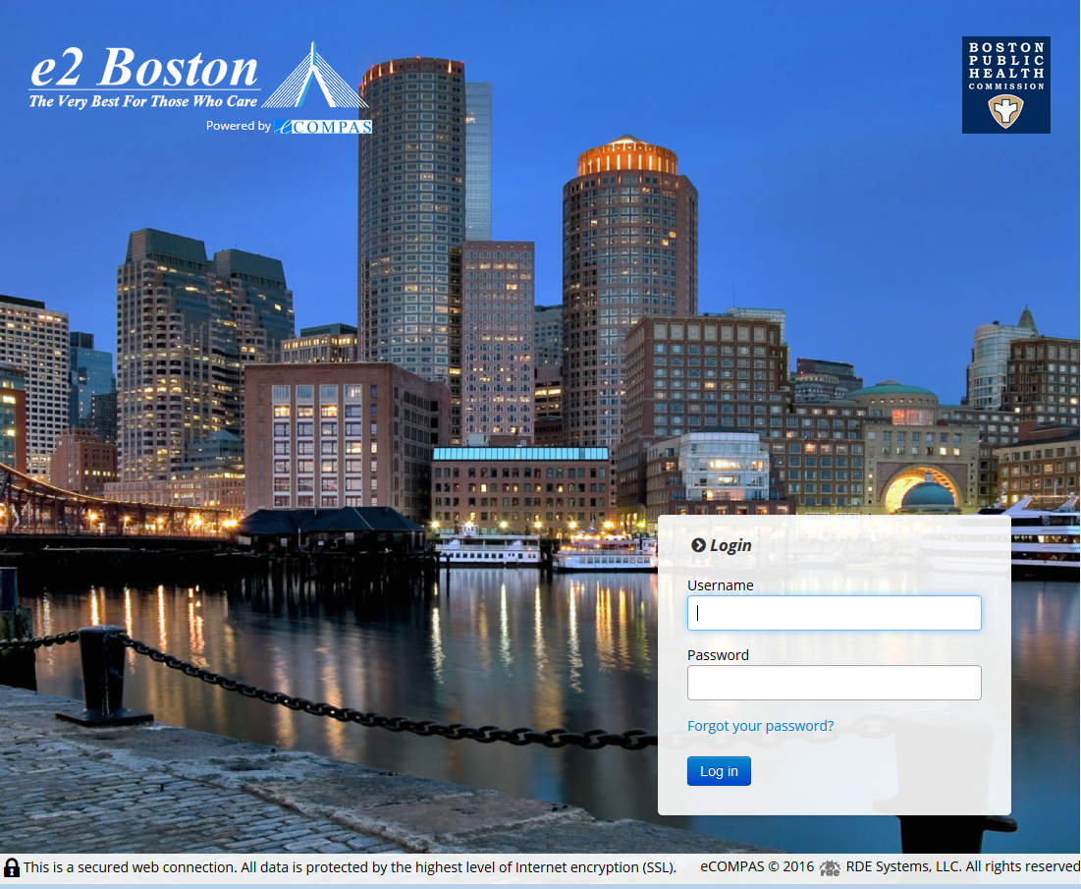
RDE was selected as the final vendor in February 2013.
BPHC launched e2Boston in March 2014 and is now well into its third year of implementation.

Slide 100
What do you do when you have champagne taste, but beer money?
The primary goal of building a data system was to at least have a system that capture all the required RSR fields and can generate the XML file.
The biggest shift for all stakeholders was the fact that this HIV data system was a website, not a desktop application that needed to be installed locally.

Slide 101
What do you do when you have champagne taste, but beer money?
In the initial year, RSR functionality was included at launch, in addition to capturing HRSA and Boston EMA-specific client demographic and service utilization data elements.
BPHC was not able to incorporate any health outcomes data elements at launch.
The site utilizes user-friendly descriptions and instructions, including plain language feedback on RSR XML errors.

Slide 102
Having plain language feedback makes it easier and quicker to fix problems with your XML file.
HAB (Check Your XML Tool) | eCOMPAS
The 'EthnicityID' element is invalid - The value '20' is invalid according to its datatype 'urn:rsrNamespace:EthnicityLkup' - The Enumeration constraint failed. | The value "20", which was entered into a <EthnicityID> tag, is invalid. You must use one of the following values for this tag: 1, 2
The 'ServiceDate' element is invalid - The value '09,01,1714' is invalid according to its datatype 'urn:rsrNamespace:dateType' - The Pattern constraint failed. | The value "09,01,1714", which was entered into a <ServiceDate> tag, is invalid. This tag may have a specific format for data (for example, dates should be in mm,dd,yyyy format with commas between each tag). It may also have restrictions on the values that can be entered (eg. date fields will not allow a year prior to 1900). Check the import manual for acceptable values/data formats for this attribute.

Slide 103
Start with a good core product and then upgrade/modify as necessary.
BPHC also operated a dental reimbursement program that needed a more comprehensive data system. A special version of e2Boston was built for the program to also collect additional clinical and diagnostic information necessary to assess and determine treatment options for PLWH receiving dental care.
This version can only be used by dental staff, but can still report data by funder so BPHC can properly account for how Part A funds are being used by the program. The system also tracks state and RW Part B funds for services.

Slide 104
e2Boston utilizes an open data standard to provide user choice.
Larger agencies, such as health centers, already utilize an existing EMR and using e2Boston as a primary system may not be an option.
BPHC and RDE worked to develop a data dictionary and data import standards that allow agencies to export data from their existing systems into a database file, which can be directly uploaded onto the e2Boston website.
Users can import client demographic, service utilization, and/or health outcome data.

Slide 105
Data import is a highly prized functionality within e2Boston.
17 of 34 funded agencies import their data.
These agencies typically serve between 100-500 clients annually.
The biggest time saver is to import service utilization data, especially for programs that provide a high volume service, such as daily congregate or home-delivered meals, office visits, or support group meetings.
Importing data is also helpful during RSR season when RSR-specific data elements must be updated for a majority of clients.
Notes:
Largest import programs serve upwards of 1500 (Dental)

Slide 106
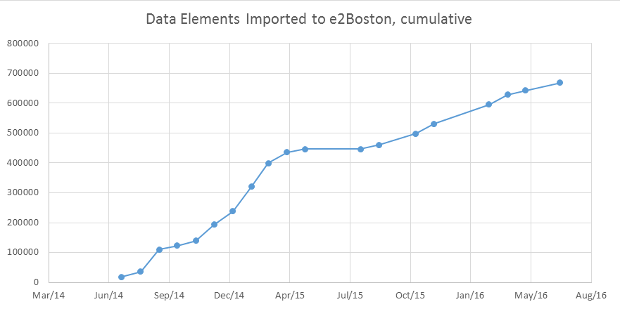
Seventeen import users imported over 600K data elements since launch.
668,000

Slide 107
Users can enter and see their data in real time.
One of the typical challenges with older processes was the lag time to get data reported, analyzed, and then used for RW activities. e2Boston allows users to report data on their own schedule.
BPHC requires that most data is reported every 3 months. Nearly half of all agencies enter data on a daily basis.
Some data import users also upload data more often than every 3 months, because smaller batches and frequent uploads encourage program staff to stay up to date on their client documentation. This reduces the need for data staff to chase after data as reporting deadlines loom.

Slide 108
Users can enter and see their data in real time.
All users can run reports at any time to review any previously entered data, whether it’s two years ago or 10 minutes ago.
Providers can enter their work for the week, run a report showing total volume of services, and then send a copy of that report to their supervisor.
e2Boston also features advanced visual analytics that allow users to generate tables and graphs for internal usage, BPHC reporting, or data for grant applications.

Slide 109
The HIV Care Continuum is everywhere and now it’s in e2Boston.
In March 2015, BPHC released a health outcomes module, which allows providers to use the same interface to now submit client demographic, service utilization, and outcomes data.
Data import for outcomes was available at launch.
Some of BPHC’s outcomes include: HIV viral suppression, housing status, last medical visit date, mental health.

Slide 110
Viral suppression is the ultimate goal.
VS is tracked on the client level within e2Boston. Providers can identify individuals or cohorts that are not suppressed and target them for services.
BPHC has dramatically shifted its focus on improving viral suppression (VS) and requires agencies to review the VS rates among their clients. From FY15 data, 89% of Part A clients reported an undetectable* viral load.
Procurement activities now require that applicants be able to report on their current VS rates and compare against the EMA/state continuum of care.
* Undetectable = less than 200 copies/mL.

Slide 111
Lessons learned through this process:
Development and implementation should be done in a speedy manner, because lengthy delays can make your project obsolete
Building a system that people will actually use and be mindful of the user experience
In order for providers to fully take advantage of any data system, they must have real-time access to their own data – this is essential for tackling viral suppression

Slide 112
See how the Boston EMA tracks VS!
Exhibition Hall, P110
Title: Identifying significant indicators of unsuppressed viral load in the Boston EMA

Slide 113
e2Boston will keep evolving.
One-click HIV care continuum at agency, service category, and EMA levels
Fiscal reporting and cost accounting functionality, a necessary component for unit-rate services
Client enrollment data sharing, allowing providers to send RW eligibility information to others in the Part A network

Slide 114

NYC Department of Health and Mental Hygiene
Transitional Health Care Coordination
The Whoosh: Innovative Data Exchange
National Ryan White Conference
August 2016

Slide 115
Rationale / Challenges
One Stop Career Center Puerto Rico
Damian Family Care Centers Bronx, NY
Inconsistent care:
Limited access to:
Short jail stays
Re-entry services
Correctional health discharge planning
Multiple providers
Transportation assistance
Part-time ID specialist
Coordinated care
Substance use
Notes:
Although we have managed to successfully reduce ER visits in NY (through our SPNS) >>> as a result of the issues listed above engaging pts in regular primary care is still a challenge
PR: limited social services exist for those upon re-entry (as provided by one stop)
Clinics etc are available, but do not coordinate and can be difficult to access (transportation!)
NY:
We have discharge planning for select populations (working to expand)

Slide 116
Practice Transformation Model
One Stop Career Center Puerto Rico
Notes:
Jail based services:
HIV testing is universal, and not opt in
Transitional Care Coordination:
Introducing health education, patient navigation, court advocacy, and TRANSPORTATION
Community-based services:
OSCC already offers vocational training, social services, and housing assistance
Introducing case management, coordination of medical and social services, and linkages to care

Slide 117
Practice Transformation Model
Damian Family Care Centers Bronx, NY
Adapt Hampden County’s Public Health Model for Correctional Health*
Train Nurse Practitioners as HIV specialists
Incorporate Community Health Worker
NP / CHW follow patients from Bronx jail at community clinics
Share EHR and eCOMPAS TCMS
Incorporate EPIC substance use program
*http://www.mphaweb.org/PublicHealthModelforCorrectionalHealth.htm
Notes:
Having a single medical provider will increase continuity of care
Same provider increases patient comfort, disclosure, and hopefully retention in care
Empowering People to Initiate Change (EPIC) > dedicated substance abuse treatment program dorm
>> by building the relationship in jail (prior to release) we will increase use of PC rather than ER

Slide 118
Steps toward Implementation
One Stop Career Center Puerto Rico
Identify staff:
Train staff in HCCM
State certified HIV counselors
  Transportation:
  Transportation Service
  Identify sustainable funding
Coordinate with Corrections:
Access to correctional facilities
Patient health records
Engage Key Stakeholders:
Establish a Consortium
Linkage Agreements
Meet with Clients
Notes:
OSCC trainings include HIV, medical case management, stigma
Coordinate with DOC for access, work space, security, projected discharge dates (within 120 days)
Talk about meeting with formerly incarcerated and their feedback> critical need for transportation

Slide 119
Steps toward Implementation
Damian Family Care Centers Bronx, NY
Identify / train staff:
Identify NP and CHW
Train NP and CHW
Share health and care management records:
Access jail EHR at DFCC clinics
Create Transitional Care Management System
Add TCMS portal for DFCC
Patient Rosters:
Provide discharge plans
Coordinate with Damian EPIC program
Key Stakehold Collaborations:
Damian to join THCConsortium
DOC logistics for EPIC program
Notes:
EPIC- we need DOC assistance in designating housing area, providing security, and ensuring participants aren’t transferred prior to completion

Slide 120
… to Launch
One Stop Career Center Puerto Rico
Damian Family Care Centers Bronx, NY
Execute transportation contract
Access to jail health records
IRB approval (submitted 6-3-15)
Staff training
Site visit to Hampden County jails
Access to TCMS
IRB approval

Slide 121
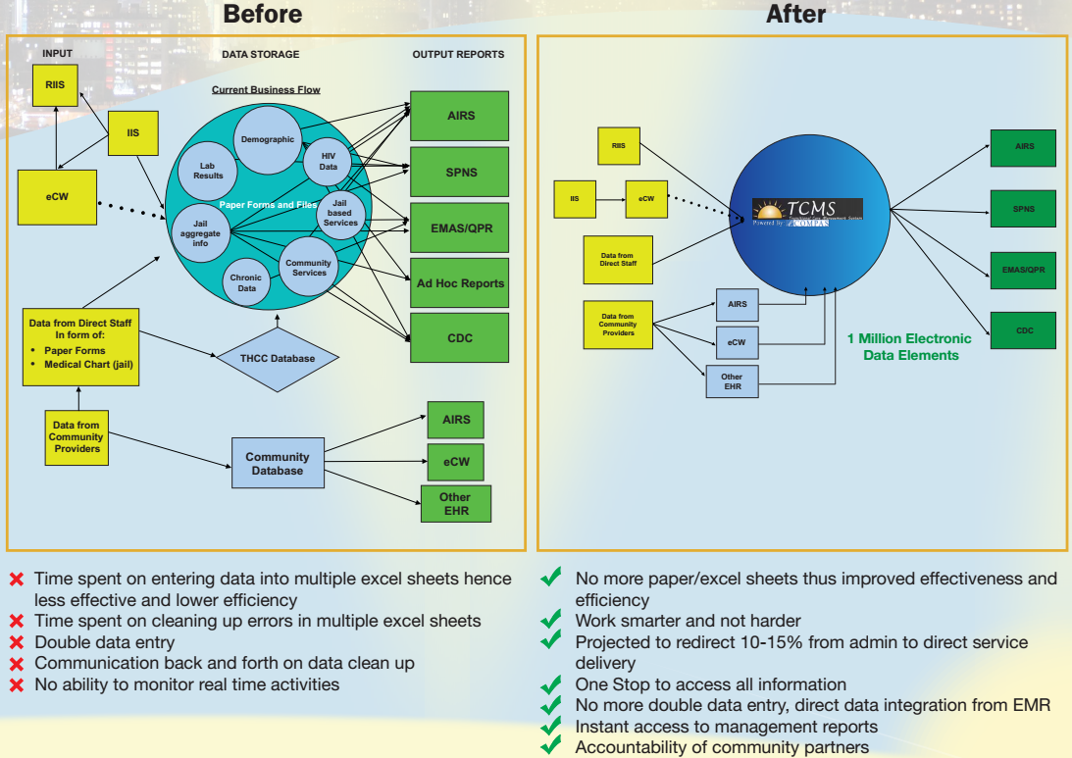
… to Launch

Slide 122
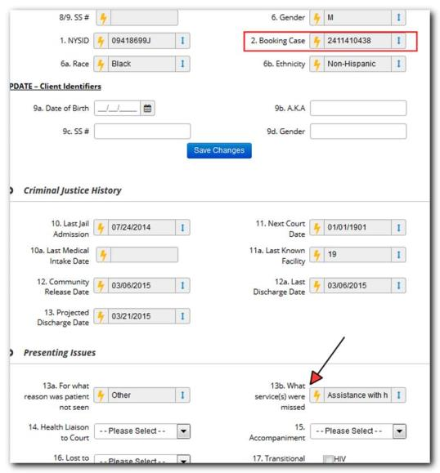
The Whoosh! … ecW to eCOMPAS data flow

Slide 123
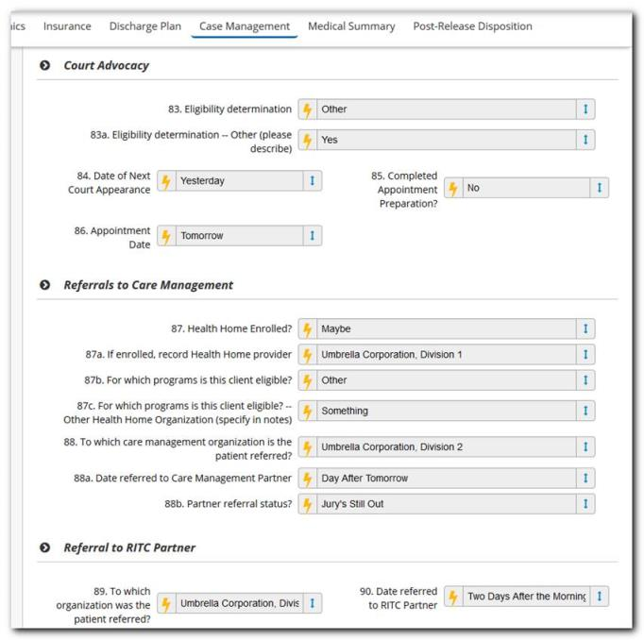

Slide 124
TCMS Data Feeds (the Whoosh!)
3.8 million data points imported into TCMS

Slide 125
10-15% savings in admin costs

Slide 126
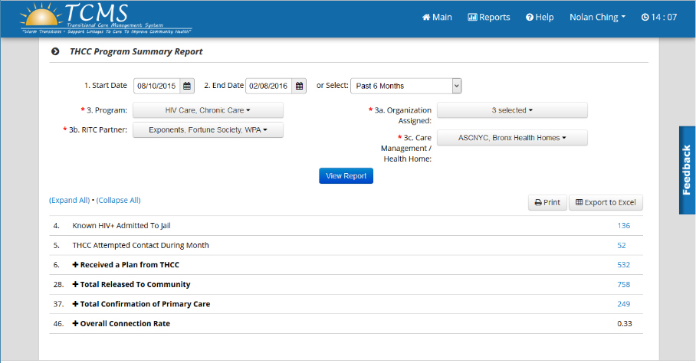
TCMS Program Summary Report

Slide 127
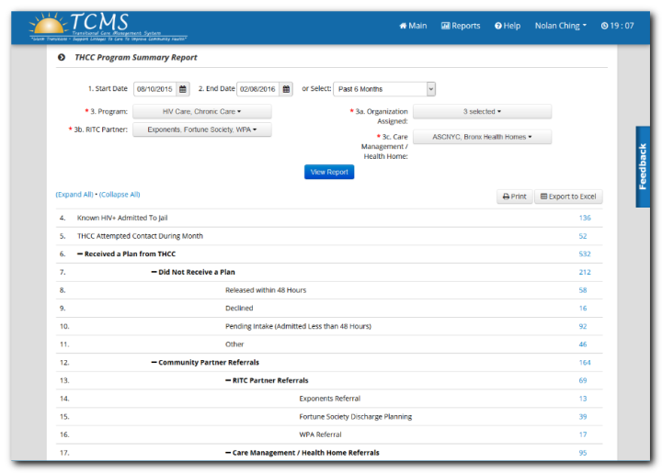
Collapse-expand feature

Slide 128
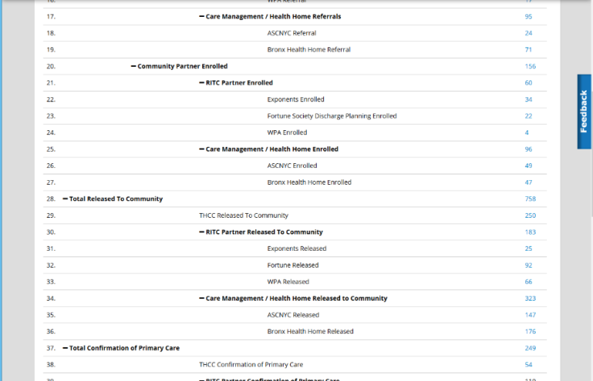

Slide 129
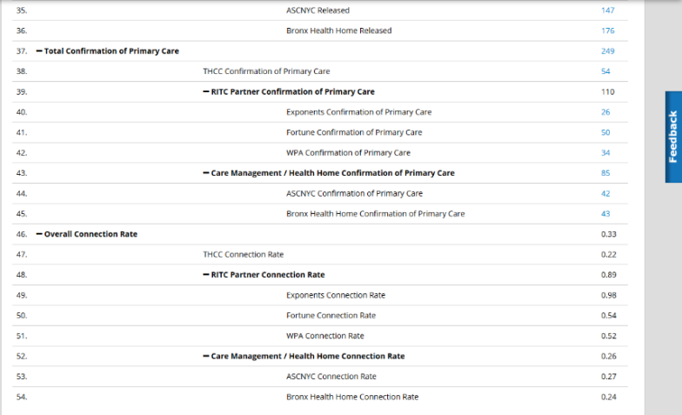

Slide 130

Client Drill downs

Slide 131
TCMS Future vision
Real time TCMS access to community partners
Summary reports and ad hoc reports to guide partners for practice transformation
Client Data Sharing between community partners
Multi lingual capabilities
Expanding the whoosh to send data from eCOMPAS to other data systems.

Slide 132
Q & A

Slide 133
Wrap Up

Slide 134
Contact Information
Ray Higa
Planner
Hawaii Department of Health, STD/AIDS Prevention Branch
www.hawaii.edu
Eric Thai
Interim Division Director/Director of Client Services
Boston Public Health Commission
ethai@bphc.org
Alison Jordan
Executive Director, Transitional Health Care Coordination
New York Health + Hospitals
ajordan@nychhc.org
Jesse Thomas
Jesse@rde.org
973-773-0244 x1001
www.e-compas.com
Notes:
134

