Slide 1
Approaches to practice transformation to improve outcomes along the HIV Care Continuum
Panel Session
Notes:
Required slide. Please complete

Slide 2
Integrating Quality Improvement and Population Health Approaches into Panel-based Care through Practice Transformation: A SPNS Initiative
Susan Olender, MD, MS
Mila González, MPH
Jesse Thomas, BA
NewYork-Presbyterian Hospital
Comprehensive Health Program
Notes:
Required slide. Please complete
----- Meeting Notes (8/25/16 08:35) -----
I am Susan Olender.
For this talk we will be telling you about our efforts to integrate CQI and population health into our PTM through development of panel-based care and a novel HIT dashboard.

Slide 3
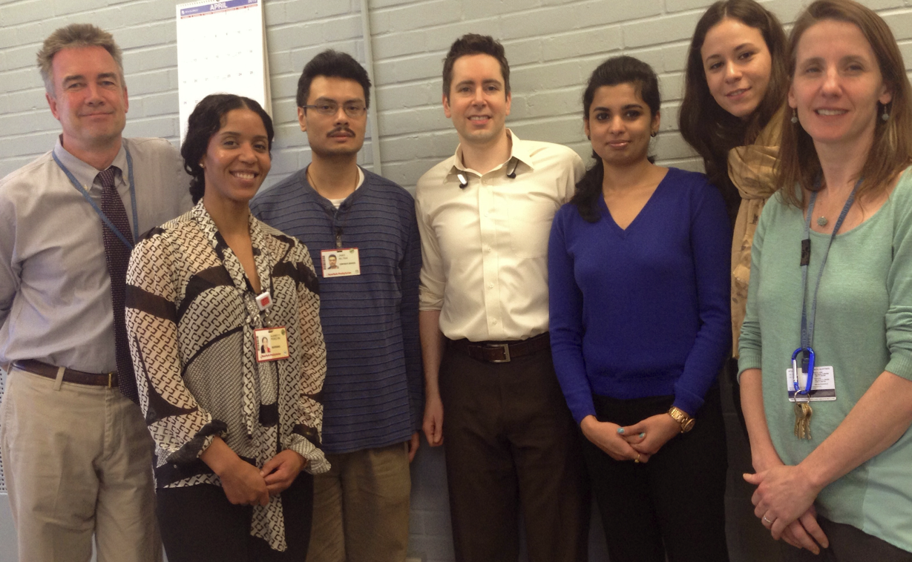
STaR SPNS Team
Susan Olender
Principal Investigator
Mila Gonzalez
Project Director
Audrey Perez
Clinical Care Coordinator
Marilena Lekas
Evaluator
James Beltran
Data Coordinator
Jesse Thomas
HIT Consultant, RDE
Anusha Dayananda
HIT Consultant, RDE
Notes:
----- Meeting Notes (8/25/16 08:35) -----
This is our SPNS project team.
I am joined today by Mila Gonzalez who is the SPNS Project Director and Quality Manager and Jesse Thomas of RDE who is our IT consultant.
I'd also like to point out and thank Anusha Dayananda of RDE who is our Project Manager IT consultant.
and Audrey Perez our Project RN Care Coordinator, James B and our Med Director Peter Gordon - also our mentor.

Slide 4
Outline
Practice Transformation Model at the Comprehensive Health Program
  Needs Assessment and Planning the Practice Transformation
  Implementation of Treatment Adherence Program through Primary Care Nursing
Development of Health Information Technology (HIT) for Population Health Management and Quality Improvement
Integrating Quality Improvement into Panel-Based Care
Notes:
----- Meeting Notes (8/25/16 08:35) -----
There are 3 parts to this talk:
First I'll tell you about our program and why PT was so necessary and what the PTM consists of.
Then Jesse and Mila will highlight two of the main components:
development of our IT Dashboard through RDE systems.
transformation of our program into Quality Teams.

Slide 5
1) STaR’s Practice Transformation: A SPNS Initiative

Slide 6
Comprehensive Health Program
Academic medical center in Upper Manhattan, NY
Provides outpatient & inpatient care to people living with or at-risk for HIV
Over 2,200 outpatients with HIV and 20 bed inpatient unit
Growing attention to at-risk population, PrEP, and STI services
Approximately 100 staff operating in a variety of settings: inpatient, outpatient, community, and home visits
Multidisciplinary clinical care
    Providers, nurses, social workers, care coordinators, nutritionist, psychiatrists, patient navigators, medical and nursing assistants

Slide 7

SPNS Workforce Initiative
Project Title: Stimulating Transformation of Technology and Team Structure to Reach People Living with HIV
  4-Year SPNS Grant
  Funded to design, implement, evaluate, and disseminate the intervention
Multi-site: 15 demonstration sites across the country
“Practice Transformation Models” or PTMs
  System level staffing changes
  Heavily based on Patient Centered Medical Home (PCMH)
  Improves capacity to care for people living with HIV, valuing efficiency and sustainability
  Optimizes resources in changing landscape
  Improves linkage, engagement, retention in care, and suppression rates
Cross-site Evaluation
  UCSF’s Evaluation and Technical Assistance Center (ETAC)
Notes:
Design
Implement
Evaluate
Disseminate
Changing healthcare landscape
Hiv provider shortages, increased access
is a multi-site demonstration and evaluation of system-level changes in staffing structures to improve health outcomes along the HIV Care Continuum. The initiative's fifteen demonstration sites for four years to promote the design, implementation, and evaluation of innovative strategies to increase organizations’ workforce capacities and achieve efficient and sustainable service delivery practices that both optimize human resources and improve quality outcomes. The demonstration projects will implement and evaluate innovative Practice Transformative Models (PTMs) for the delivery of HIV treatment and comprehensive care services in order to better respond to the changing healthcare landscape, marked by shortages of HIV primary care physicians and increasing demand for access to quality HIV services. Evaluation of these innovative PTMs will identify best practices and methods to support other organizations to adapt and re-align their workforces, as well as factors that increase the potential for successful integration of HIV care into primary care and community healthcare settings serving vulnerable populations. The University of California at San Francisco is serving as the Evaluation and Technical Assistance Center (ETAC) for this initiative. The ETAC will coordinate the multi-site evaluation; provide programmatic technical assistance to the demonstration sites; and lead publication and dissemination efforts of best practices and lessons learned.

Slide 8
Demonstration Sites
New York and Presbyterian Hospital, New York, NY
Bright Point, Bronx, NY
New York City Department of Health and Mental Hygiene, Rikers Island, NY
UPMC Presbyterian Shadyside, Pittsburgh, PA
La Clínica del Pueblo, Washington, DC
Florida Department of Health, Kissimmee, FL
FoundCare Inc., West Palm Beach, FL
University of Miami, Coral Gables, FL
The MetroHealth System, Cleveland, OH
Access Community Health Network, Chicago, IL
Hektoen Institute for Medical Research (Core Center), Chicago, IL
Coastal Bend Wellness Foundation, Inc., Corpus Christi, TX
Special Health Resources for Texas, Inc., Longview, TX
Family Health Centers of San Diego, Inc., San Diego, CA
Centro de Salud de la Comunidad de San Ysidro, Inc., San Diego, CA
Notes:
Rikers – will train 2 midlevel practitioners to expand capacity at two locations – Bx and Puerto Rico; Increase support for clients leaving incarceration in two sites for PLWH
Core Chicago – addresss transistions from inpatient to outpatient with clinical transition liaison and Community health workers.
San Ysidro – residency training of family medciine residents to deverliy care; RN
La clinica DC – community health workers, patient disease self management
Sites are quite different and are responding to the needs in their local area.
There are sites that focus on:
Trainings (increase supply of providers – family medcine
Share the care – task shifting within the organization, rn panel managers, community healht workers
Decreasing the demand – reducing inpatient/acute care needs through community health workers, link retain and engage/re-engage

Slide 9
Stimulating Transformation:
Needs Assessment
Care coordination
  Inefficiencies in identifying who to follow-up
  Separate programs for adherence, care coordination, nursing care, medical care
Communication
  Complex communication patterns
  Multiple staff members in various settings with variable communication
  Untapped opportunities for efficiencies through HIT
Accessibility
  Many providers are not on-site full time (fellows, researchers, etc.)

Slide 10
Stimulating Transformation:
Needs Assessment
Staff working at the top of their license
  Opportunities with experienced nursing team:
    Primary Care Nursing
No-shows and walk-ins
  High no-show rates resulting in lost capacity
  Need for strengthening patient access to same-day walk-in care

Slide 11
STaR Practice Transformation Model:
Providing More Care Through Harmonious Redesign (without sacrificing quality)
Enhanced
Communication
Panel-Based
Clinical Care Team (Quality Teams)
Efficient Use
of Clinical Space
Integrating Health Information Technology (HIT) for Population Health Management
Coordinated Care Across Settings
Notes:
Panel-based clinical care teams
Improve communication patterns
Shifting coordination of care to more RN-SW led model
Support coordination and education of the clinical care team with Clinical Care Coordinator
Centering medication adherence support with each team’s nurse
Clinical support for navigators and community health care workers
Coordination of care across care settings (inpatient, outpatient specialty, community) and provision of clinical supervision for field-based navigators.
Updates to HIT to support team discussions (population health) and create efficiencies
Enhanced walk-in and same day capacity for clinician visits
Expand capacity through patient centered use of clinical space
Improve communication with consumers (team information sheet, RHIO consent, myNYP)

Slide 12
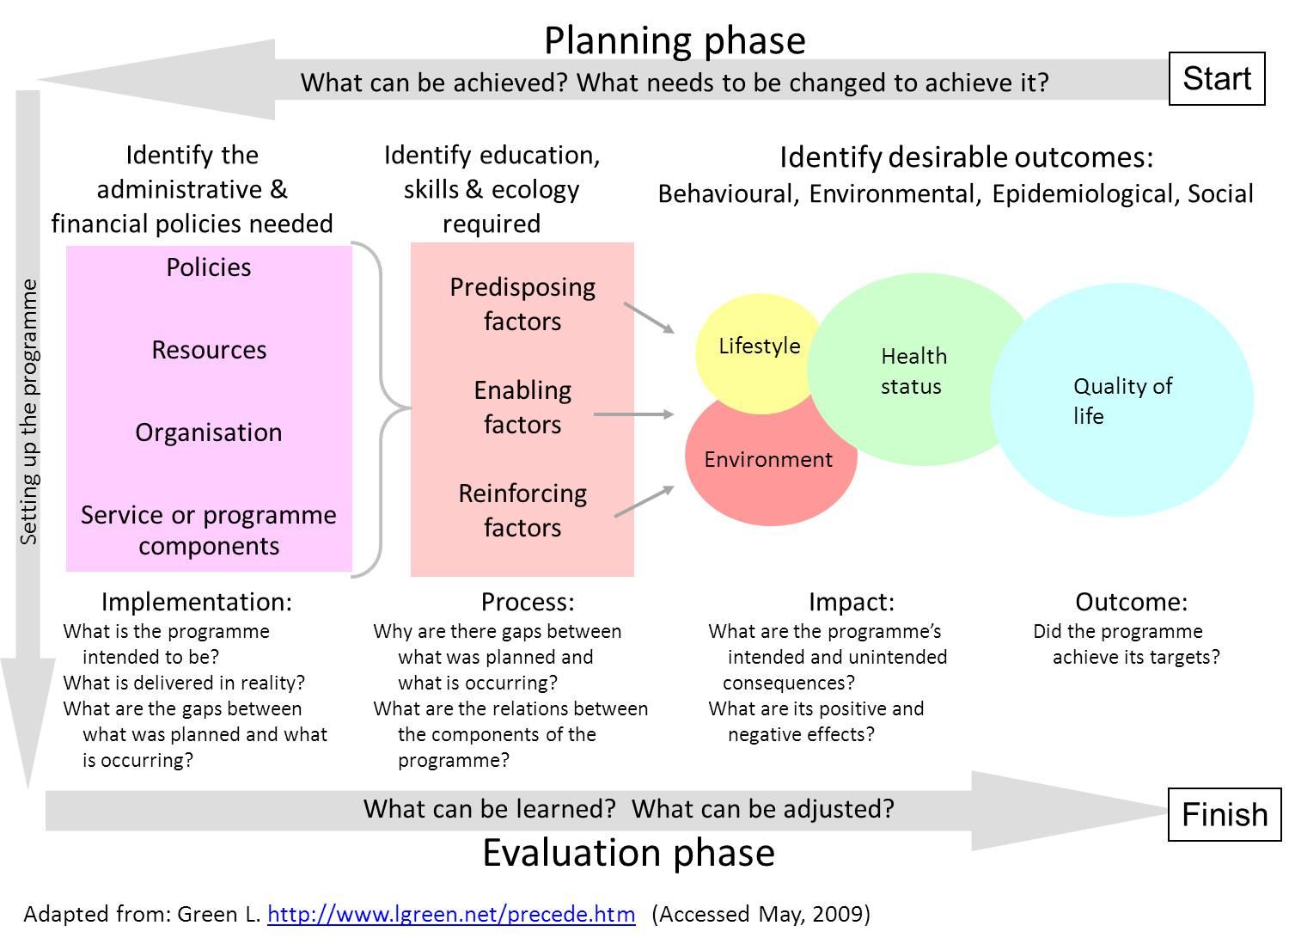
Planning the Practice Transformation:
PRECEDE PROCEDE Framework
Notes:
----- Meeting Notes (8/25/16 08:35) -----
We are working with the PRECEDE PROCEDE model which allows us to focus on outcomes taking into account resources, processes and predisposing, enabling and reinforcing factors and permitting us to idenitify lessons learned and adjust/pivot.

Slide 13
CHP Program Impact Pathway
(Logic Model)
Notes:
----- Meeting Notes (8/25/16 08:35) -----
We have formalized our own logic model with outcomes including
enhanced access, better coverage and improved quality
with goals of impacting wellbeing and improved health PLWH

Slide 14
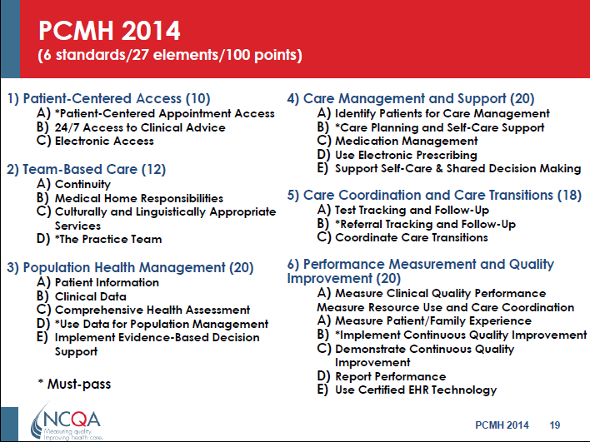

Slide 15


Panel-Based Clinical Care Teams &
Coordinated Care Across Settings
STaR Clinical Care Coordinator at the Comprehensive Health Program
CCT A
Social Worker(s)
Registered Nurse
CCT B
Social Worker
Registered Nurse
CCT C
Social Worker
CCT D
Social Worker(s)
Registered Nurse
Registered Nurse
Clinicians
Care Coordinators
Clinicians
Care Coordinators
Clinicians
Care Coordinators
Clinicians
Care Coordinators
Patient Navigators
Patient Navigators
Patient Navigators
Patient Navigators
  STaR Clinical Care Coordinator:
  Dedicated to supporting the care team structure
  Provide clinical support to
    Care Coordinators
    Patient Navigators
    Community Health Workers
Care Enhancements:
Better communication
Social Worker co-lead Clinical Care Teams
Medication adherence through Primary Care RN
Adherence Supervisor, Case Managers, Community Health Workers, Peer Educators, Nutritionist, Psychiatrists, Patient Financial Advisors, & Other Staff
Notes:
----- Meeting Notes (8/25/16 08:35) -----
And these next few slides should give you a sense of how we put the teams together.
With each of these next steps I should also mention that there is always stakeholder input and a LOT of communication.

Slide 16
Building the Clinical Care Teams

Slide 17
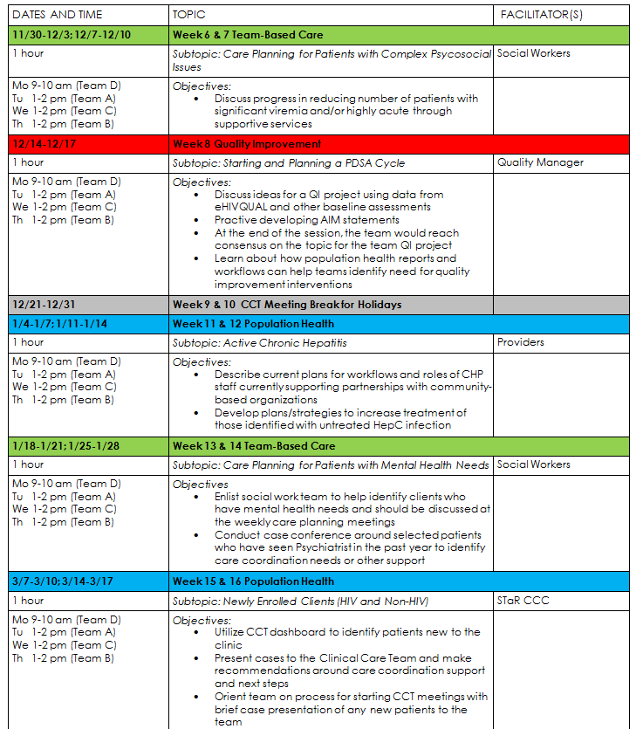
Coordinating Weekly Care Team Meetings
RN Care Coordinators send out daily email reminders
Pre-meeting planning between RN Care Coordinators and Social Worker (Team Co-Captains)
Theme-based discussion calendar
Review of Dashboard indicators

Slide 18
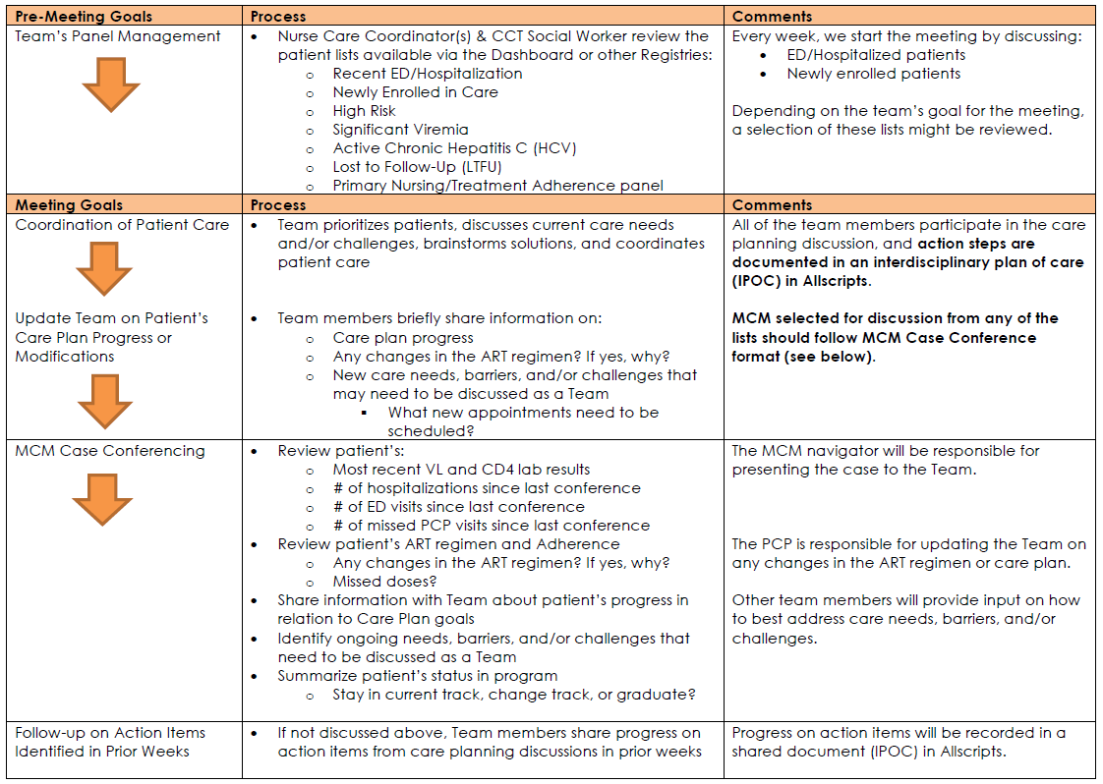
Patient Discussion Structure

Slide 19
2) HIT Development

Slide 20
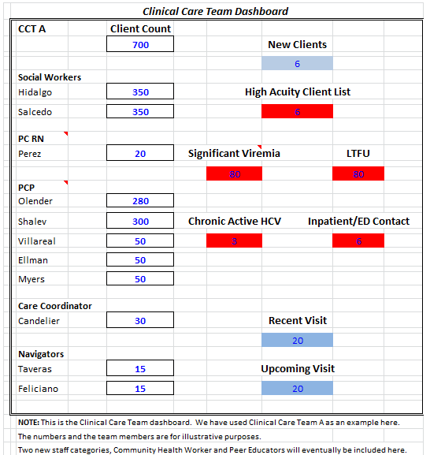
Integration of Health Information Technology (HIT) for Population Health Management
Updates to HIT to support team discussions (population health) and create efficiencies
Collaboration with RDE Systems
Dashboard design
Adding additional key clinical indicators

Slide 21
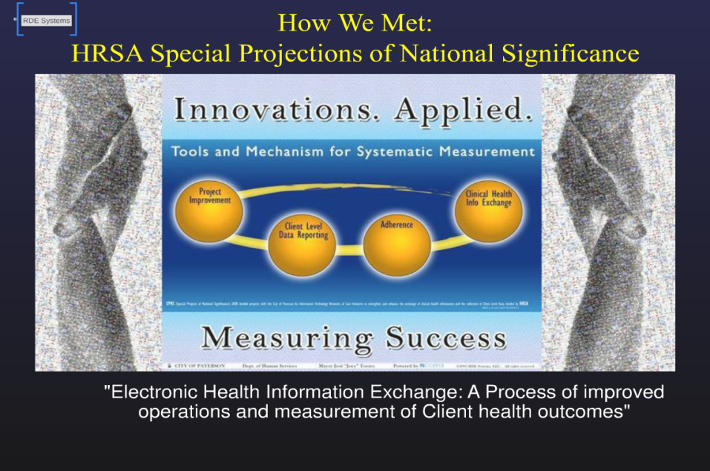

Slide 22
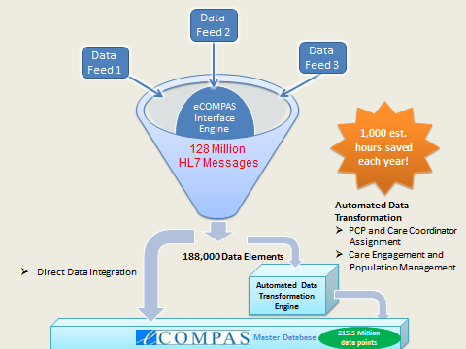

Slide 23
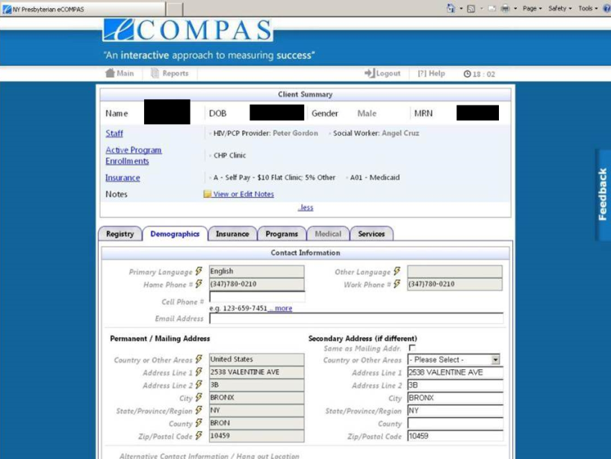

Slide 24
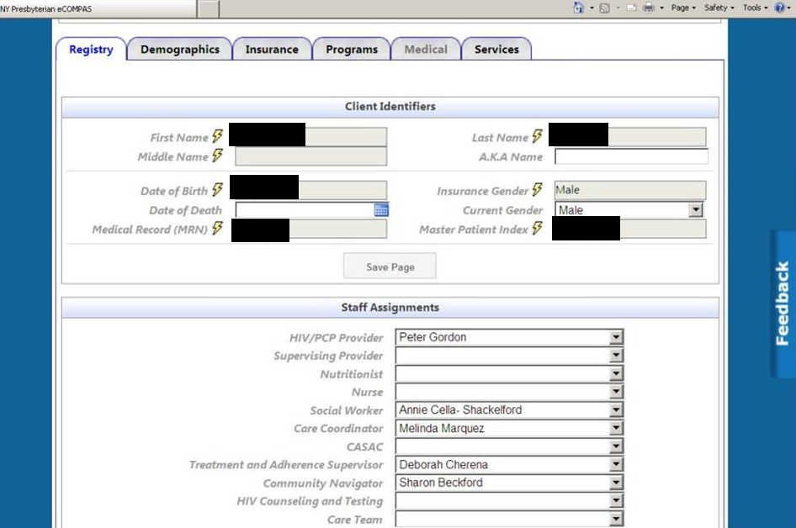

Slide 25
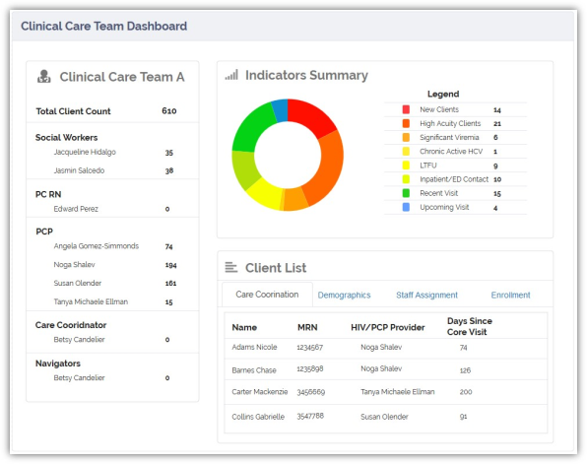
Creating Efficiencies – including Primary Care Nursing as Part of the CCT Dashboard
Notes:
Need Dashboard shot with PC Nursing included
Describe efficiencies of management …

Slide 26
How does this transformation occur in the clinic and how can stakeholders drive the process?

Slide 27
3) Practice Transformation and
Quality Improvement
“If we want safer, higher-quality care, we will need to have redesigned systems of care, including the use of information technology to support clinical and administrative processes.”
Committee on the Quality of Health Care in America
(Institute of Medicine, Crossing the Quality Chasm, 2001)
Notes:
The restructuring of the staff into Care Teams focusing on the coordination of care for patients with complex psychosocial and medical care needs, and the development of a Team Dashboard to facilitate population health management, are goals of a high-quality of care.
At the same time, these efforts have resulted in the growth of the Quality Infrastructure at our Practice, including mainstreaming of Continuous Quality Improvement or “Process Improvement” strategies for planning, implementing, and measuring system-level changes.
In the next couple of slides we will show you how the Quality Program at our clinic is facilitating the systematic gathering of information about the function of our systems, and then making changes to processes with the goals of optimizing care and achieving better patient health outcomes.

Slide 28
Implementing Practice Transformation through a Quality Framework
ACN QPS
QI (or “Patient Care Improvement”) Teams
STaR Work Groups
Program Monitoring
Quality Assurance & Regulatory Compliance
Monthly Review of Program Performance
Program Outcomes Evaluation
Staff Surveys & Focus Groups
Patient Surveys
Outcome Measures Review (CHP/State/Regional)
CHP Quality Program
PDSAs
NYP QPS Goals and Metrics
CHP Goals and Metrics
Nursing QPS
Notes:
The Quality efforts at the Comprehensive Health Program are guided by:
Hospital-wide Quality and Patient Safety goals and metrics as defined by the Nursing and Ambulatory Care Network Quality Infrastructure as well as;
CHP-specific goals and metrics corresponding to special initiatives and programs implemented only locally at our clinic through grant-funding
The Practice Transformation Quality work at our clinic can be categorized into four main activities:
First, we have transformed our Clinical Care Teams into Quality Improvement or Patient Care Improvement Teams responsible for implementing QI improvement projects through Plan-Study-Act-Cycles or PDSAs
We also have created Working Groups focusing on emerging quality topics at our Practice including Medication Distribution and Adherence Support, Transitions of Care, and Patient Access.
The Quality Program is supporting the monitoring of outputs for all of our HIV Medical Services, Sexual Health Services, Hepatitis Care and Treatment, as well as Supportive Services like Medical Case Management, as well as implementing quality assurance activities to ensure that what we say we are doing, we doing them as planned and meeting regulatory or grant-specific requirements.
We are also supporting process and outcome evaluation of our program, for example, by calculating our local HIV Care Cascade Outcomes on a quarterly basis as well as by conducting semi-annual staff surveys and focus group data to evaluate the success of our clinic-wide quality efforts implemented through our Practice Transformation.
Finally, we are also tracking patient satisfaction survey data and will be implementing tablet-based patient surveys in the clinic to evaluate targeted interventions to improve Patient’s Satisfaction with Provider Communication.
For the rest of my presentation, I’m going to focus on the practical application of Quality Improvement principles and strategies at our Practices to transform our Clinical Care Teams to Teams that are not only concerned with Coordination of Patient Care but that are to implement Continuous Quality Improvement.

Slide 29
Quality Improvement Model
Notes:
Some tools are based on theoretical frameworks, such as Lean
Manufacturing, Six Sigma and the Model for Improvement, whereas others are
more pragmatic (1). Each framework has a unique focus and addresses slightly
different problems. However, each seeks to help staff with the challenge of
getting evidence or innovation into practice reliably and efficiently, and it is
common for organisations to adopt aspects of more than one framework in
their quality improvement endeavours. They are described below.
Research Quality Assurance Process Improvement
Purpose To discover new
knowledge
To continuously
measure compliance
with standards; reactive
To apply knowledge into
daily practice; proactive
Focus Variable Individual data, Outliers Systems, Processes
Participation Few Few All
Data As much data as
possible, “just in case”
Whatever is required
for compliance
“Just enough” data to
learn
Duration Can take long periods of
time to obtain results
Variable – retrospective
chart reviews or
automated reports
Small tests of significant
changes accelerates the
rate of improvement
Deliver the most value
from your customer’s perspective
while consuming the fewest resources
using the creative talent of our people.
Use continuous improvement to increase the portion of the work that is value added,
instead of building a larger waste delivery system.
What is the
problem?
Who are the
customers and
what are their
needs?
How is the process
performing and how is it
measured?
What are the root
causes of the
problem?
How do we address the
causes of the problem?
How can we
maintain the
improvements?
Total Quality Management (TQM) or Continuous Quality Improvement (CQI) techniques for measuring quality problems, designing interventions and their implementation, along with process re-measurements.
Plan
is answering the questions in the first three steps above –
setting aims, establishing measures, and selecting changes. It
happens when we meet in the conference room with the
team.
Do
is implementing the changes. It happens when we train
the nurses, and educate the doctors and the patients. It
happens when we use “bundles”, which are packages of
evidence-based interventions that help in providing
consistency of care.
Study
is evaluating the pilot change to see if it produced the
desired effect.
Act
is to adopt, reject or modify the change plan, so that the
next cycle can begin
Culture
■
A culture of quality should exist throughout the organisation.
Quality should be prioritised over other issues and every member of
staff should be involved in delivering and improving quality.
Aims
■
The needs of the customer or patient are paramount, with the
key aim being delivery of quality as perceived by the customer.
Collaboration
■
Teamwork, evidenced by joint learning, planning and
service delivery, is critical to the organisation’s work.
Training
■
Specific tools and techniques are employed to improve
quality, rather than intuition and consensus alone. As with any science,
there is a need to train staff to apply these.
Anti-perfectionism
■
It is never assumed that ideas for service
improvement will be perfect. Even seemingly excellent ideas are
tested and refined through practical implementation before being
fully adopted. Similarly, care is never judged to have become perfect.
GP Inquiry Paper
6
The King’s Fund 2010
Quality is presented as a journey, requiring one to be always asking
new questions and finding new solutions.
Measurement
■
When assessing processes and outcomes, extensive
use is made of data, to identify areas needing improvement and
evaluate the impact of changes.
Small steps
■
The use of small pilots or ‘tests of change’ (11) is
used to implement innovations as a means to refine plans through
identifying and removing problems before wide-scale roll-out.
Standardisation
■
Ad hoc customised solutions are sometimes
necessary, but standardised approaches to similar problems are
preferred, in order to benefit from measurement, refinement,
teamwork and economies of scale.

Slide 30
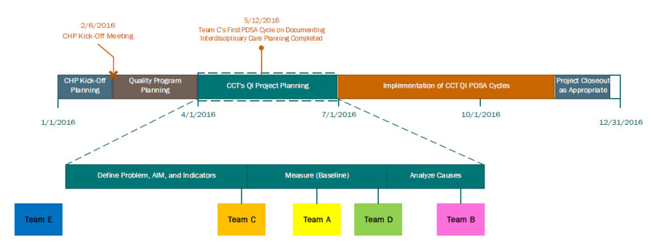
Care Teams QI Projects Timeline

Slide 31
Facilitating Transformation: Updating the Treatment Adherence Program
“Jumpstart” Adherence Program defunded
Pre-poured pillboxes paired with education are essential adherence support intervention for patients
Opportunities to use Nursing expertise in medications and patient education
  Prevention of Medication errors
Nurses as an integral part of the Clinical Care Teams

Slide 32
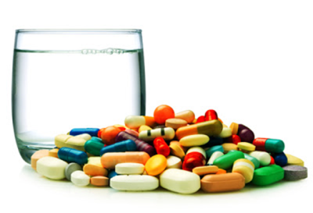
Nurses Working at the Top of License
Medication distribution & reconciliation and adherence support through Primary Care Nursing

Slide 33
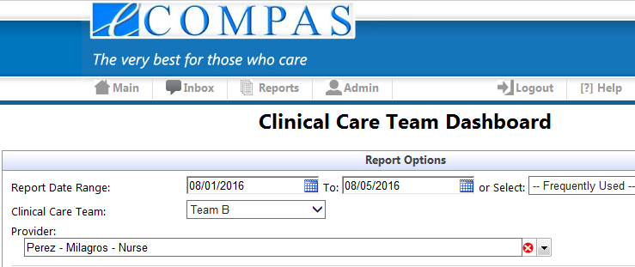
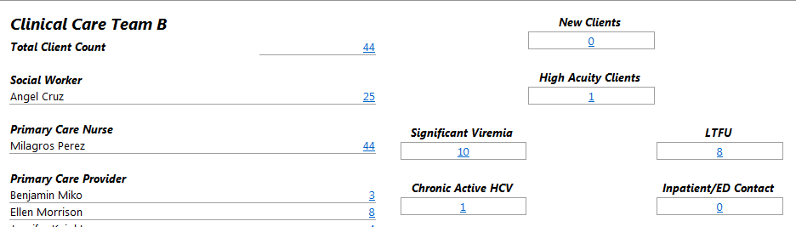
CCT Dashboard: Primary Care Nursing

Slide 34
STaR Working Group on Medication Distribution & Adherence Support
Working Group consisted of representatives from each of the stakeholder groups with interest:
    Registered Nurses
    Nurse Administrator
    Physicians
    Adherence Supervisor
    Operations Manager
STaR Team facilitated the creation of the Working Group and participated in the meetings

Slide 35
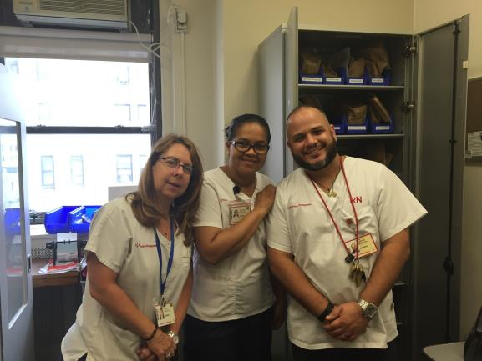
Building on a Strength and Engaging Stakeholders for Transformation

Slide 36
Planning Implementation of
New Treatment Adherence Program
Review the old process and policies with the following goals:
  Identify issues
    Medical errors
    Reconciliation issues
    Large number of patients pick-up medication (~200 patients)
  Identify opportunities for transformation
    Nursing expertise in medication and education
    Nursing now committed to dedicated Clinical Care Team (CCT)
  Solutions
    Shrink pick-up list
    Move medication reconciliation and adherence pick-up under Nursing
    Nursing will be able to guide CCT meetings with up to date knowledge

Slide 37
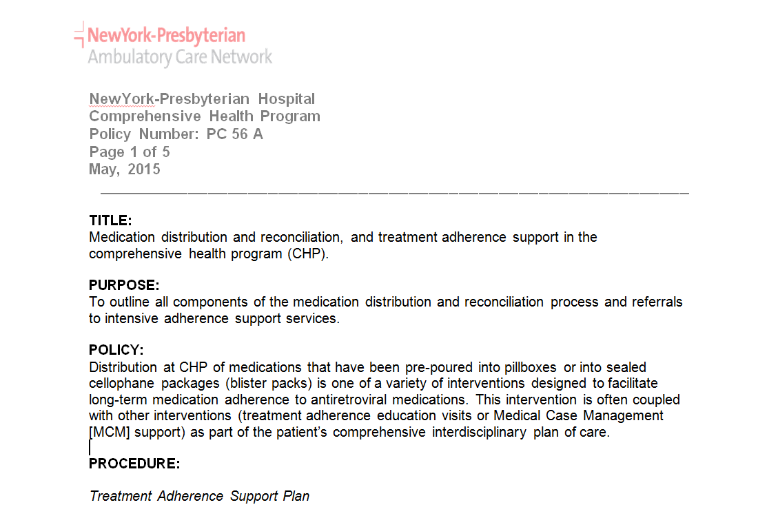
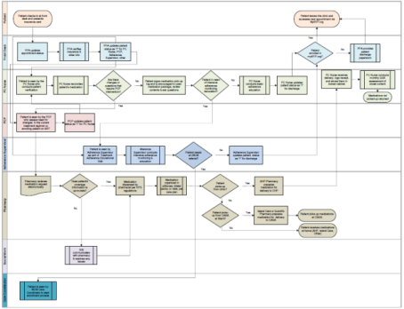
Updating Protocol & Workflows

Slide 38
Changes to the Medication Distribution &
Adherence Program Workflow
First Work Group Meeting on
Medication Distribution, Reconciliation, & Adherence
September 2015
August 2015
April 2015
2 Week Pilot
New Medication Distribution via RNs
Clinical Care Teams Review Program Enrollment & Proposes Graduation from Program
Medication Distribution Shifts to RNs, Updates to Adherence Program Policy and Workflow Finalized

Slide 39
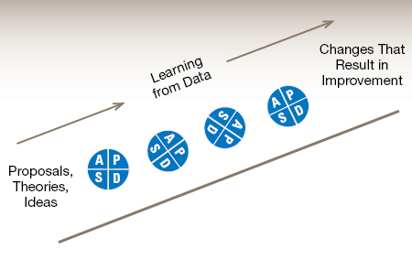
Implementation Mid-Course Corrections: Plan, Do, Study, Act Cycles
Small changes
Iterative process
Data-driven
Notes:
Some tools are based on theoretical frameworks, such as Lean
Manufacturing, Six Sigma and the Model for Improvement, whereas others are
more pragmatic (1). Each framework has a unique focus and addresses slightly
different problems. However, each seeks to help staff with the challenge of
getting evidence or innovation into practice reliably and efficiently, and it is
common for organisations to adopt aspects of more than one framework in
their quality improvement endeavours. They are described below.
Research Quality Assurance Process Improvement
Purpose To discover new
knowledge
To continuously
measure compliance
with standards; reactive
To apply knowledge into
daily practice; proactive
Focus Variable Individual data, Outliers Systems, Processes
Participation Few Few All
Data As much data as
possible, “just in case”
Whatever is required
for compliance
“Just enough” data to
learn
Duration Can take long periods of
time to obtain results
Variable – retrospective
chart reviews or
automated reports
Small tests of significant
changes accelerates the
rate of improvement
Deliver the most value
from your customer’s perspective
while consuming the fewest resources
using the creative talent of our people.
Use continuous improvement to increase the portion of the work that is value added,
instead of building a larger waste delivery system.
What is the
problem?
Who are the
customers and
what are their
needs?
How is the process
performing and how is it
measured?
What are the root
causes of the
problem?
How do we address the
causes of the problem?
How can we
maintain the
improvements?
Total Quality Management (TQM) or Continuous Quality Improvement (CQI) techniques for measuring quality problems, designing interventions and their implementation, along with process re-measurements.
Plan
is answering the questions in the first three steps above –
setting aims, establishing measures, and selecting changes. It
happens when we meet in the conference room with the
team.
Do
is implementing the changes. It happens when we train
the nurses, and educate the doctors and the patients. It
happens when we use “bundles”, which are packages of
evidence-based interventions that help in providing
consistency of care.
Study
is evaluating the pilot change to see if it produced the
desired effect.
Act
is to adopt, reject or modify the change plan, so that the
next cycle can begin

Slide 40

Treatment Adherence Program QI Team
Clinical Care Team A
Treatment Adherence Supervisor
All RNs (4)
STaR Project Director /Quality Manager

Slide 41
QI Project AIM
Increase, over a period of three months initially, the proportion of patients outreached, re-engaged and/or referred to other internal resources (e.g., Treatment adherence educator, Medical Case Management, or peer education) by those directly involved in implementing adherence support for CHP clients out of those patients enrolled in the program and who are failing to pick-up their medication or need additional adherence support.

Slide 42
Intermediate AIMS
Regulatory
  Decrease number of medications returned to Pharmacy.
Intervention Monitoring
  Achieve real-time monitoring of missed medication pick-ups
Improve care coordination among those involved in treatment adherence monitoring and support
  Care Teams at Clinic, Community Partner Staff, Nursing Team

Slide 43
CHP Adherence Program Population (February 2016):
Viral Suppression (<200copies/mL) Rates by Teams
N=150
Overall, 64% viral suppression rate.

Slide 44
CHP Adherence Program Population (February 2016): Last Viral Load > 6 month
N=23

Slide 45

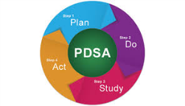
PDSA Work Plan
Action Step | Details | When | Who
1) Develop and maintain Adherence Program population report through eCOMPAS | Get an updated list from AHF of patients picking-up at CHP; and Enroll patients in the Program in eCOMPAS and maintain list so it is up-to-date | Ongoing | STaR Data Coordinator
2) Develop med pick-up tracking system | Develop medication pick-up patient list and tables for monitoring missed medication pick-ups | End of May | Treatment Adherence Supervisor (TAS)
3) Medication pick-up weekly afternoon huddle | Implement Friday afternoon huddle with RN and TAS to further refine weekly reports of missed medication pick-ups and protocol; identify patients to be outreached and discussed at CCT meetings | Beginning of July | RNs, TAS, and other team members as needed
4) Identify patients for CCT meeting discussion | Patient discussion might result in an intervention including but not limited to: 1) referral to peer program, 2) referral to TAS, 3) referral to MCM, 4) need to be outreached and scheduled for PC visit. | Beginning of July | RNs, TAS, and other team members as needed

Slide 46
Changes to the Medication Distribution &
Adherence Program Workflow
December 2015
March 2016
July 2016
Primary Care Nursing Panels in CCT Dashboard Updated
Start of QI Discussions at CCTs Meetings, and Team A Proposes PDSA
Nursing Panel Reviews at CCT Weekly Meeting Start
PDSA Implementation Starts: Weekly Friday Afternoon Huddles, Meds put on Hold, and Targeted Patient Outreach

Slide 47
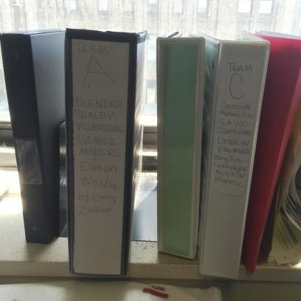
Team QI PDSA Progress
(What We Have Accomplished)
Coordinated with AHF Pharmacy to receive an accurate master list of patients picking up meds at CHP
Reviewed Master Medication Delivery logs and Medication Pick-Up logs for all teams
Conducted four afternoon huddles in July with RNs, TAS, and Quality Manager
Created an Adherence Program patient tracking list

Slide 48
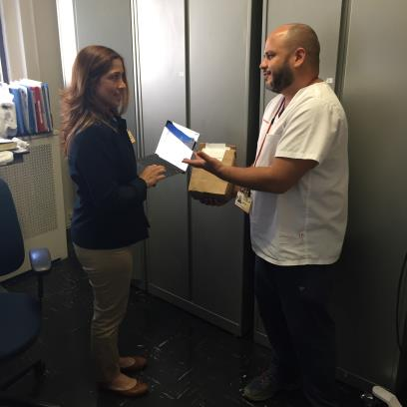
Team QI PDSA Progress
(What We Have Accomplished)
TAS coordinating with AHF Pharmacy for reducing the # of meds returned (because patients not picking up)
Through weekly Friday afternoon huddles, ensuring that all meds are returned per Hospital regulations
Identified patients in need of additional support and conducted outreach through the TAS

Slide 49
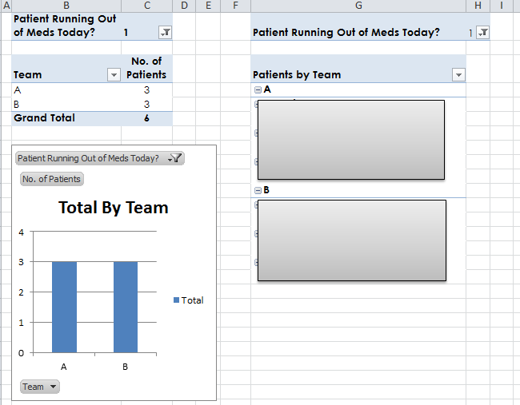
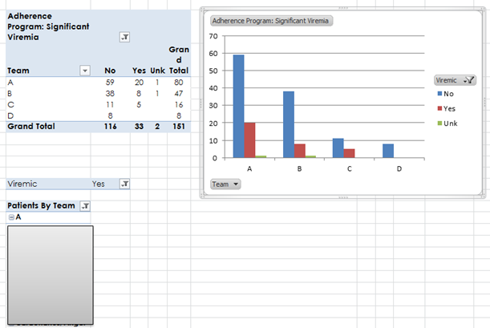
Meds Missed Pick-up & Viral Load Suppression Tracking Tool Tables

Slide 50
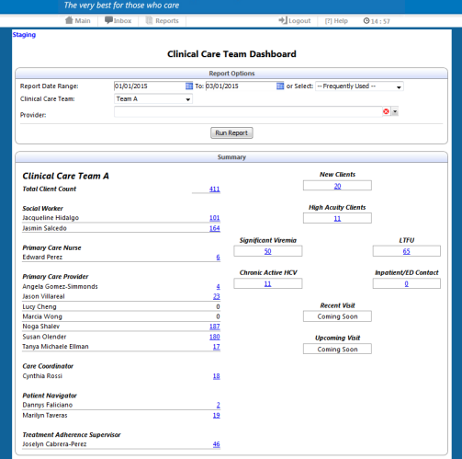
Creating Efficiencies –Adherence Program Indicators in the CCT Dashboard
Adherence Program
Notes:
Need Dashboard shot with PC Nursing included
Describe efficiencies of management …

Slide 51
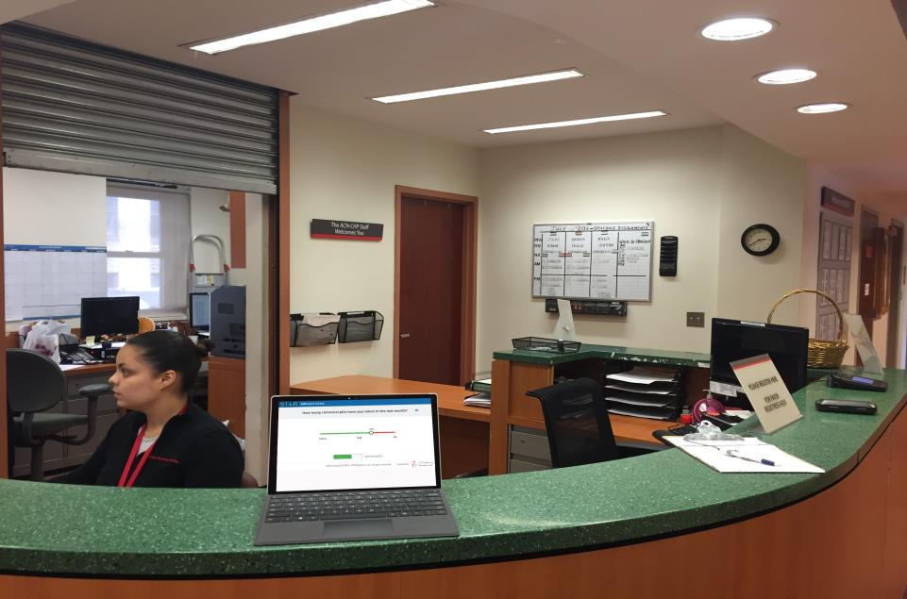

Slide 52
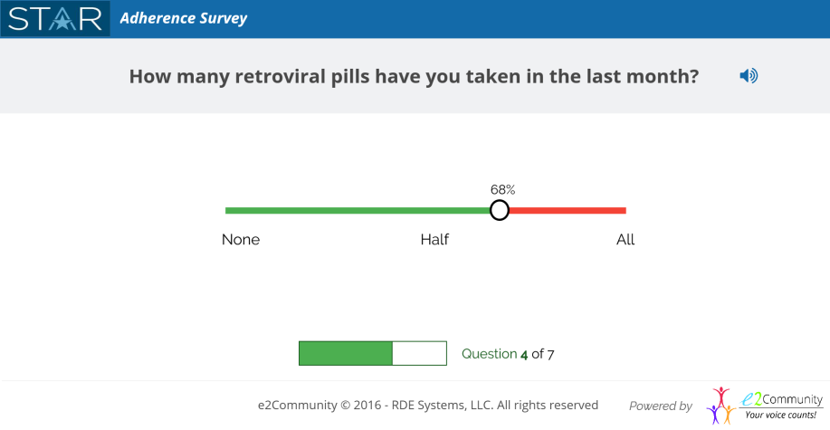

Slide 53
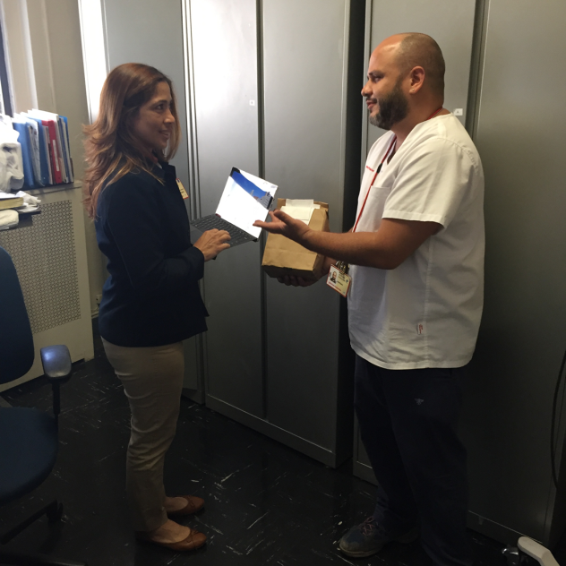

Slide 54
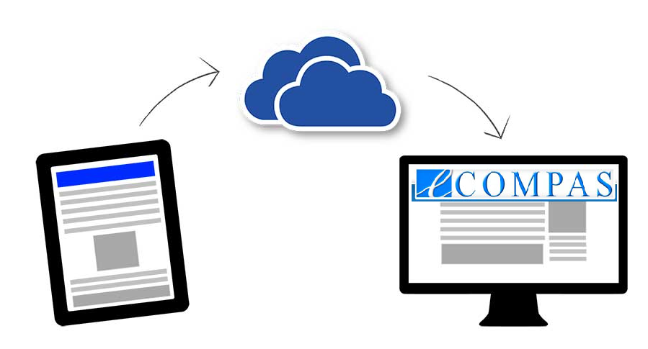
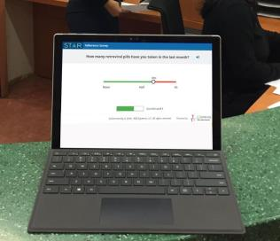
Secure Data Transfer

Slide 55
Summary
Involving stakeholders in all the stages of process improvement and transformation
Building trust
Using HIT solutions to achieve efficiencies and enhance communication
Employing QI approaches or tools allow for systematic assessment of changes
Leveraging Clinical Care Team to support continuous quality improvement

Slide 56

Questions

