Slide 1
Innovative Special Project of National Significance (SPNS): Fusing Part A, B, C, & D Data for MyCareContinuum Dashboard and Empowering Consumers with an Award-Winning Low-Health-Literacy Patient Portal
Milagros Izquierdo, Division Director, City of Paterson Department of Health and Human Services, Ryan White Part A, MAI and HOPWA
Patricia H. Virga, PhD., Vice President Consulting Services, New Solutions, Inc.
Jesse Thomas, Project Director, RDE System Support Group, LLC
Dr. Peter Gordon, MD, Medical Director, New York Presbyterian Hospital Comprehensive Health Program
Notes:
Required slide. Please complete

Slide 2
Disclosures
The City of Paterson, Department of Human Services, New York Presbyterian Hospital and New Solutions, Inc. have no financial interest to disclose.
Jesse Thomas works as Project Director for RDE System Support Group, LLC.
This continuing education activity is managed and accredited by Professional Education Services Group in cooperation with HSRA and LRG. PESG, HSRA, LRG and all accrediting organization do not support or endorse any product or service mentioned in this activity.
PESG, HRSA, and LRG staff has no financial interest to disclose.
Notes:
Required slide. Please complete section under Presenter

Slide 3
Learning Objectives
At the conclusion of this activity, the participant will be able to:
Recognize how a paradigm of fusing disparate data sources across funding silos can enhance quality improvement.
Describe how to replicate and adapt strategies and tools to implement novel approaches to impacting the outcomes along the HIV Care Continuum.
Identify, analyze and evaluate the pitfalls and benefits of implementing health information exchange, including the adoption of federal Office of the National Coordinator (ONC) standards.
Notes:
Required slide. Please complete

Slide 4
Introduction
Coordinating systems through eHIE
The Bergen-Passaic TGA

Slide 5
Introduction
City of Paterson Department of Health and Human Resources Ryan White Grants Division
In existence since 1994
Services located across two counties and concentrated in the epicenters of Paterson, Passaic and Hackensack
Ryan White Programs and Providers
16 Ryan White Part A
4 Minority AIDS Initiative (MAI)
6 HOPWA sub-recipients
Notes:
(1 min 30 seconds) The City of Paterson administers Ryan White Part A, MAI and HOPWA grants on behalf of the Bergen-Passaic TGA. We provide services within the epicenters with a network of 15 Part A, 4 MAI and 6 HOPWA providers. This year, we conclude our second decade of caring for persons with HIV/AIDS.

Slide 6
Our Story
Building on SPNS Electronic Exchange of Health Information - Networks of Care
Using Data to Impact Process and Health Outcomes

Slide 7
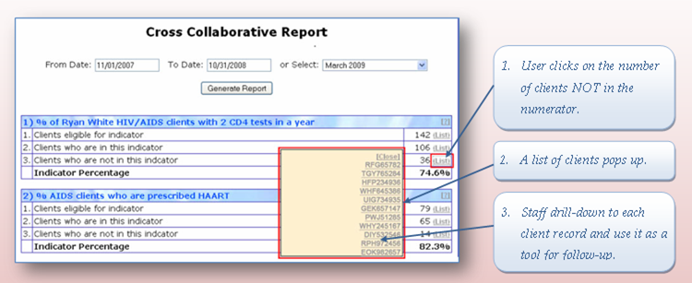
eCOMPAS Interactive Quality Reporting

Slide 8
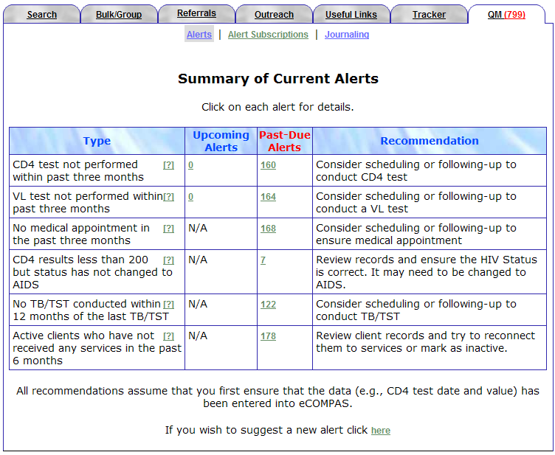
Agency Alerts

Slide 9
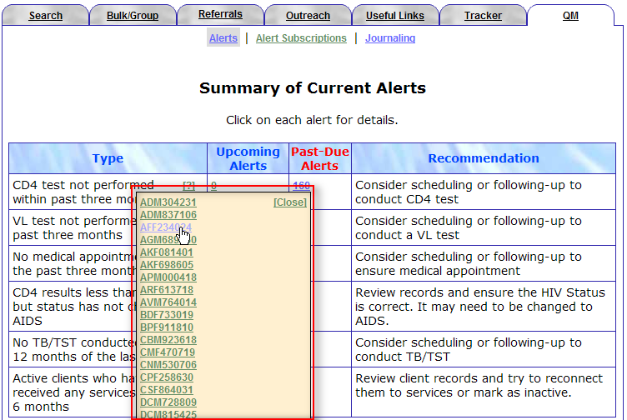
Agency Alerts Drilldown

Slide 10
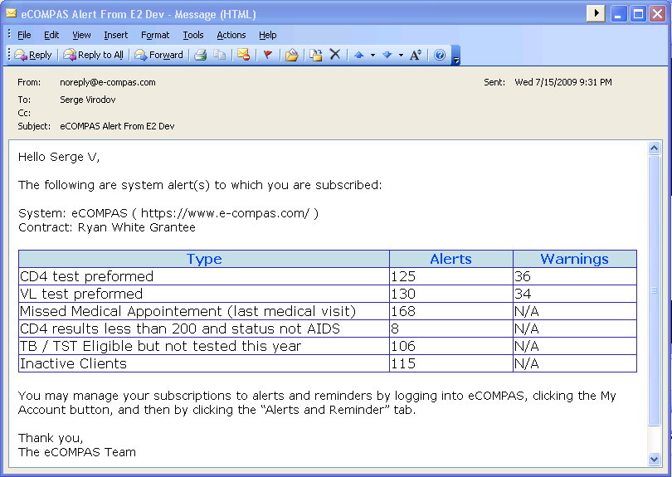
Email Alerts
Proactive, regular, push notification
Supervisors are more likely to read email

Slide 11
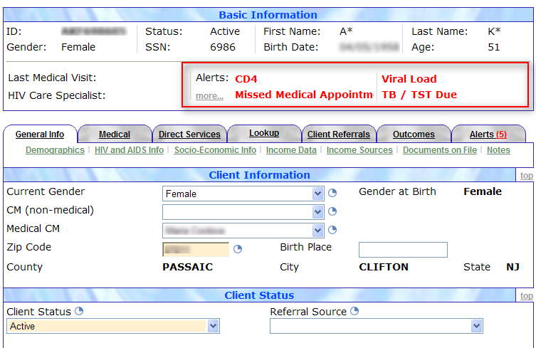
Linked to Exact Screen

Slide 12
Outcomes

Slide 13
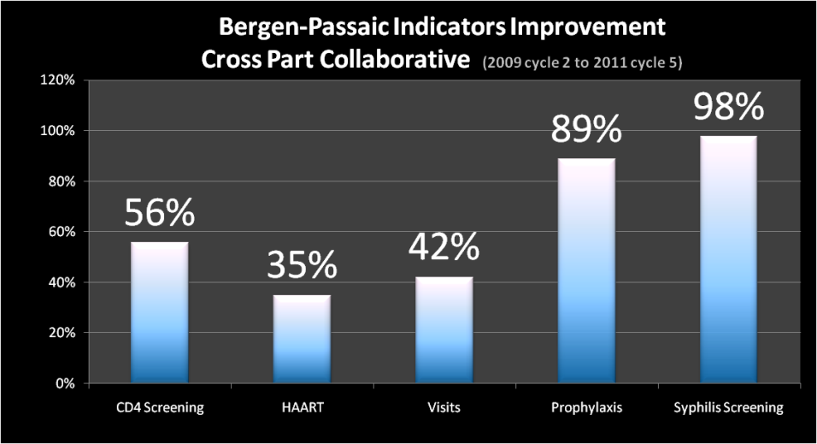
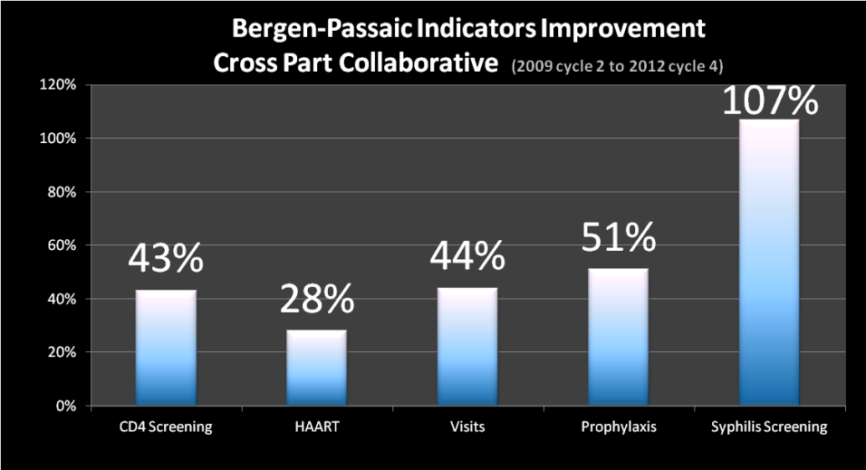

Slide 14
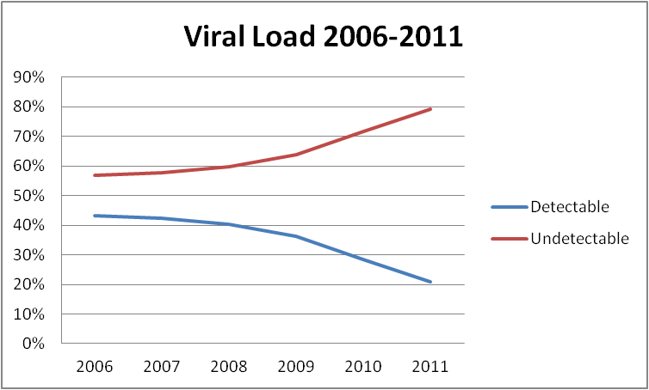
Data entry + charts
SPNS
QM + Alerts
Undetectable VL improved 38.6%
2006-2007 prior to SPNS, all medical patients

Slide 15
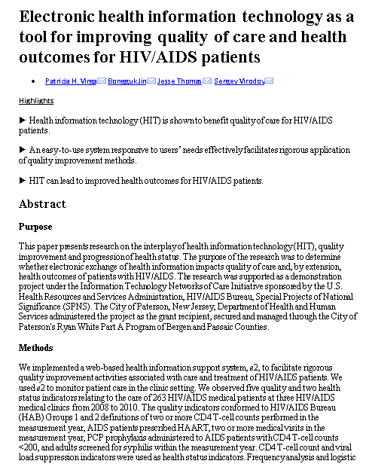
International Journal of Medical Informatics, August 2012

Slide 16
(from left to right) Denise Coba, Pat Virga, Jesse Thomas, Millie Izquierdo, Jimease Green, Maria Cordova, Doug Mendez, Pricilla Moschella, Jerry Dillard, Ellen McNamara, Larry Rodgers, Blanca Roman, Anthony Fazzinga, Sandra Murillo, Maryann Collins, Irene Panagiotis, Serge Virodov, Chantia Douglas, Kathy Lebron.

Slide 17
SPNS 2014 Program Goal
Create a coordinated regional system of HIV/AIDS medical services, joining outreach, HIV testing, early intervention and HIV medical providers to ensure that all individuals at risk for HIV have access to HIV testing, timely disclosure of test results, and rapid linkage to medical care, access to ARV therapy and sustained viral suppression.
1

Slide 18
Objectives
Construct the Regional (RWHAP) and Local HIV Care Continuum as an interactive Continuum that allows the user to view any sub-section desired.
Import data from NJ-DHSTS (Part B) into eCOMPAS
Import data from St. Joseph’s Hospital and Medical Center HIV Services (Part A, C and D) into eCOMPAS

Slide 19
Project Components

Slide 20
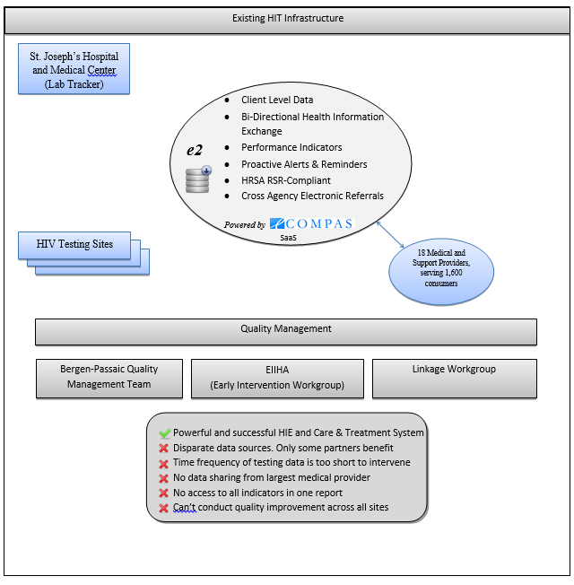
7
Notes:
By Jesse- (3min) Provide a brief description and purpose of the proposed project
→Indicate whether this involves developing a new or the enhancement of an existing central data repository
→Include the proposed system configuration(s) of your HIT capacity building project

Slide 21
MyCareContinuum
Goal 3
eP-TAS People Taking Action, Saving Lives
St. Joseph’s Hospital and Medical Center (Lab Tracker)
Outreach Data + Linkage Data
Testing Data + Care Data
Client Level Data
Bi-Directional Health Information Exchange
Performance Indicators
Proactive Alerts & Reminders
HRSA RSR-Compliant
Cross Agency Electronic Referrals
Goal 1
e2
Goal 2
Expanded Health Information Exchange (eHIE)
MyCareContinuum Dashboard
Surveillance Data
Powered by
Full Care Continuum Data
eHARS
SaaS
Personal Health Record Data
Goal 4
18 Medical and Support Providers, serving 1,600 consumers
Low Health Literacy Patient Portal
18 Medical and Support Providers, serving 1,600 consumers
18 Medical and Support Providers, serving 1,600 consumers
Goal 5
MyCareContinuum Collaboratives
Bergen-Passaic Quality Management Team
in+care Initiative
NQC Cross Part Collaborative
New Jersey Dept. of Health
Clients / Patients / Consumers
Powerful and successful HIE and Care & Treatment System Outreach, Linkage, Testing, and Surveillance integrated Expanded central, secure data warehouse Bi-monthly aggregate State surveillance data Near real-time data from largest medical provider Partners can access real time data reporting Quality Improvement activities and PDSA enabled
Notes:
Animated slides

Slide 22
-
Past A
,
B
,
C
,
D Funded
-
CW User
a
r
i
n
g
-
Labs
/
Medical data
-
Part A
,
HOPWA
-
Part B
t
a
S
h
D
a
t
a
S
h
a
r
i
n
g
-
eCOMPAS
-
Surveillance Data
D
a
-
All Providers
(
53
)
have access
-
eHARS System
to data
-
Care Continuum Data
St
-
Joseph
NJ
-
DHSTS
Bergen
-
Passaic
Part A, B, C, D Data
TGA
-
Regional
(
NJ
-DHSTS
)
-
RW Only
(
St Joes
+
eCOMPAS Data
)
-
Client Drilldowns
-
Interactive Dashboard
(
Future Vision
)
MyCareContinuum
e
2
St
-
Joseph
Surveillance Data
Care Continuum Data
D
WA
a
O
P
t
a
S
/
H
a
h
t
A
a
t
a
a
r
D
r
P
i
n
g
Part A, B, C, D Data
-
Client Demographics
eCOMPAS
-
Case Management
-
Supportive Services
-
Referral
-
LKM v
2
.
2

Slide 23
Goal 1: eHIE – Part C/D provider data import

Slide 24
Objectives
Import data from St. Joseph’s Hospital & Medical Center HIV Services (Part A, B,C and D) into eCOMPAS
Construct the Ryan White HIV Care Continuum for the MyCareContinuum Dashboard
Reduce double data entry

Slide 25
Hi! HIE eHIE

Slide 26
e2St.Joseph’s
Send de-identifying Part B,C,D data to eCOMPAS
Send Identifying Part A data to eCOMPAS
eCOMPAS
MyCareContinuum Dashboard

Slide 27
Barriers and mitigation
Challenges
Mitigation
Success
Data exchange delayed - St. Joseph had their biggest move the hospital has ever seen.
St. Joseph’s data system (Aviga) was discontinued. Team was deciding on a new data system.
St. Joseph’s had to migrate historic data to the new data system selected – CAREWare
Staff was new to CAREWare and had a learning curve.
Approvals and confidentiality agreement.
Matching algorithms
SPNS team requested sample data sets from St. Joseph’s as a first step.
SPNS team is flexible on format, detail and timeframes.
Care Continuum dashboard prototype built from aggregate data in parallel.
Current status: Re-use eCOMPAS model System’s CAREWare Data import using PDE (Provider Data Export)
Proposed a win-win idea to import data into a intermediary site.
For the first time, RWHAP Part B provider agrees to explore sharing CLD with Part A Grantee.
Collaboration with St. Joseph’s data team to receive sample client level data.
With PDE data import, prevent Part A double data entry.
Data sharing and data import design.
Sample CW file received.

Slide 28
St. Joseph’s CAREWare
Export PDE from CW
(Provider Data Export)
PDE File (Access File)
Updated PDE File
Fix data in CW
Upload into e2
e2 St.Joseph’s
Erroneous data will be discarded
Clean data will be imported to e2 Database
Verify imported data under client records

Slide 29
Current Status and Next Steps
Meetings/webinars between SPNS team and St. Joseph’s team to finalize PDE template and final specifications.
Data import design has been shared with St. Joseph’s team.
RDE will give St. Joseph’s team access to e2Virginia’s demo site
Once specs are final and agreements in place, implementation will begin and prototype will be deployed for alpha testing

Slide 30
Benefits to the TGA
Expanded central, secure data warehouse
Construct the MyCareContinuum Dashboard
Allows broader analysis of Care Continuum indicators
Supports planning, quality care and collaboration
Supports coordination across the TGA in accordance with the Integrated Prevention and Care Plan
Improve Patient Outcomes

Slide 31
Benefits to St. Joseph’s
Reduce double data entry
Access to Part A Quality Program
Potential cross part reports

Slide 32
eHIE- Data Import from NJ-DHSTS (eHARS)

Slide 33
Objectives
Construct the Regional HIV Care Continuum in accordance with SPNS objectives, i.e. an interactive Continuum that allows the user to view any sub-section desired.
Institute a bi-directional data exchange between eCOMPAS and eHARS.
Focus limited resources on clients who are truly out of care
Successful collaboration with NJ-DHSTS

Slide 34
Barriers and Mitigation
Challenges
Mitigation
Success
Coordinating with NJDHSTS to receive client level eHARS data.
Client matching between eCOMPAS and eHARS.
Establishing Data Exchange Agreement.
Reviewing protocols and confidentiality policy.
NJDHSTS requirement to perform client matches before data exchange.
City of Paterson not compatible with NJDHSTS requirements for full client match
SPNS team engaged in multiple conference calls with key data personnel.
SPNS team proposed a matching algorithm using common elements between eHARS and eCOMPAS.
Proposed a win-win idea to send Part A data to the State for matching and eHARS supplementation.
Pilot test for 100 clients
Use random Reference ID to identify matching clients to comply with client confidentiality.
Expanding eCOMPAS to have the ability to capture full first and last names using advanced encryption model (LKMv2.1 -Local Key Model)
For the first time, NJ-DHSTS agrees to collaborate on Data Exchange.
SPNS team continue to collaborate with NJ-DHSTS with the intention to succeed.
If eHARS is missing data, the data exchange will help NJ-DHSTS complete eHARS data.
eCOMPAS users can enter and track full first and last names with advanced encryption model (LKMv2.1 -Local Key Model)

Slide 35
Coordinating with NJ-DHSTS to receive client level eHARS data.
100 clients pilot is complete
Full match between eCOMPAS and eHARS
SPNS team and NJ-DHSTS continue to identify mutual benefits of client level data exchange and care continuum
Consensus and agreement
Data exchange design

Slide 36
Data Exchange TGA’s Perspective
eCOMPAS
Data file from eHARS
Upload into e2
Mismatched data will not be imported
Clean data will be imported to e2 Database
Regional Care Continuum Dashboard

Slide 37
Data Exchange NJ-DHSTS’ Perspective
Data File from eCOMPAS extracted by Grantee
eHARS
Matches clients
Securely sent to NJ-DHSTS (e.g. SFTP)
Mismatched data will be not be imported
Clean data will be imported to eHARS Database.
New records created or existing records' data updated

Slide 38
Benefits to the TGA
Expanded central, secure data warehouse
Construct the MyCareContinnum Dashboard
Track Out of Care Patients using the Data from eHARS

Slide 39
Benefits to NJ-DHSTS
Expand eHARS data sources
Facilitate an Out of Care list
Replicate Data Exchange model with other EMA/TGAs.

Slide 40
Current Status and Next Steps
Data agreement executed.
100 pilot records delivered to NJ-DHSTS and all records match.
Decision point – Further collaboration under discussion.
LKMv2.1 implementation in eCOMPAS in progress.

Slide 41
Prototype

Slide 42
Paterson eCOMPAS LKMv2
Link to file

Slide 43
Goal 2: MyCareContinuum Dashboard

Slide 44
MyCareContinuum
Goal 3
eP-TAS People Taking Action, Saving Lives
St. Joseph’s Hospital and Medical Center (Lab Tracker)
Outreach Data + Linkage Data
Testing Data + Care Data
Client Level Data
Bi-Directional Health Information Exchange
Performance Indicators
Proactive Alerts & Reminders
HRSA RSR-Compliant
Cross Agency Electronic Referrals
Goal 1
e2
Goal 2
Expanded Health Information Exchange (eHIE)
MyCareContinuum Dashboard
Surveillance Data
Powered by
Full Care Continuum Data
eHARS
SaaS
Personal Health Record Data
Goal 4
18 Medical and Support Providers, serving 1,600 consumers
Low Health Literacy Patient Portal
18 Medical and Support Providers, serving 1,600 consumers
18 Medical and Support Providers, serving 1,600 consumers
Goal 5
MyCareContinuum Collaboratives
Bergen-Passaic Quality Management Team
in+care Initiative
NQC Cross Part Collaborative
New Jersey Dept. of Health
Clients / Patients / Consumers
Powerful and successful HIE and Care & Treatment System Outreach, Linkage, Testing, and Surveillance integrated Expanded central, secure data warehouse Bi-monthly aggregate State surveillance data Near real-time data from largest medical provider Partners can access real time data reporting Quality Improvement activities and PDSA enabled
Notes:
Animated slides

Slide 45
Objective
Construct the HIV Care Continuum from testing and treatment data specific to the Bergen-Passaic TGA
Provide a tool to coordinate and improve quality of HIV actions leading to optimal viral load suppression
Provide break-down and drill-down capabilities to enhance analysis, planning, quality improvement and decision-making

Slide 46
Constructing the HIV Care Continuum
General requirements
Indicators and definitions
Data harvesting
Demographic variables
Interactive prototypes

Slide 47
Two HIV Care Continua
Regional – utilizes eHARS data from NJ-DHSTS Office of Epidemiology
RWHAP – utilizes eCOMPAS data from the Part A and Part C/D databases
Each has its own data set, definitions, limitations and challenges

Slide 48
Definitions and Data Sources
Regional HIV Care Continuum
HIV Diagnosed: PLWH diagnosed in Bergen or Passaic County as of 12/31/2014; excludes deceased and persons no longer living in NJ. Source: NJ-DHSTS eHARS Surveillance System.
Linked to Care: Received least one CD4, VL test or medical visit in 12 months ending 12/31/2014. Source: NJ-DHSTS eHARS Surveillance System.
Retained in Care: Received two or more medical visits, CD4 or VL test at 60 days apart in 12 months ending 12/31/2014. Source: NJ-DHSTS eHARS Surveillance System.
ARV Therapy: Numerator = Patients in Bergen-Passaic RWHAP clinics prescribed ARV in CY 2014 as recorded in patient medical record; includes St. Joseph's Comprehensive Care Center. Denominator = Total patients enrolled in RHWAP clinics from 2010 to 2014. Excludes deceased patients. Source: eCOMPAS information system; NJ-Cross Part Collaborative (NJ-CPC) bi-monthly reports for St. Joseph’s Comprehensive Care Center.
Viral Load Suppression: Patients with <200mL achieved at last measurement in CY 2014. Source: NJ-DHSTS eHARS Surveillance System.
Age cohorts13-18, 19-24, 55-64, 65+ are estimated based on 2010 eHARS and 2014 NJ-CPC summarized reports.
RWHAP HIV Care Continuum
HIV Diagnosed: PLWH enrolled in RWHAP since 2010. Source: eCOMPAS information system; NJ-Cross Part Collaborative (NJ-CPC) bi-monthly report for St. Joseph’s Comprehensive Care Center.
Linked to Care: Received least one CD4, VL test or medical visit in 12 months ending 12/31/2014. Source: eCOMPAS information system; NJ-Cross Part Collaborative (NJ-CPC) bi-monthly report for St. Joseph’s Comprehensive Care Center.
Retained in Care: Received two or more medical visits, CD4 or VL test at 60 days apart in 12 months ending 12/31/2014. Source: eCOMPAS information system; NJ-Cross Part Collaborative (NJ-CPC) bi-monthly report for St. Joseph’s Comprehensive Care Center.
ARV Therapy: Numerator = Patients in Bergen-Passaic RWHAP clinics prescribed ARV in CY 2014 as recorded in patient medical record; includes St. Joseph's Comprehensive Care Center. Denominator = Total patients enrolled in RHWAP clinics from 2010 to 2014. Excludes deceased patients. Source: eCOMPAS information system; NJ-Cross Part Collaborative (NJ-CPC) bi-monthly report for St. Joseph’s Comprehensive Care Center.
Viral Load Suppression: Patients with <200mL achieved at last measurement in CY 2014. Source: eCOMPAS information system; NJ-Cross Part Collaborative (NJ-CPC) bi-monthly report for St. Joseph’s Comprehensive Care Center.
Age cohorts 13-18, 19-24, 55-64, 65+ are estimated based on 2014 NJ-CPC reports.

Slide 49
Demo

Slide 50
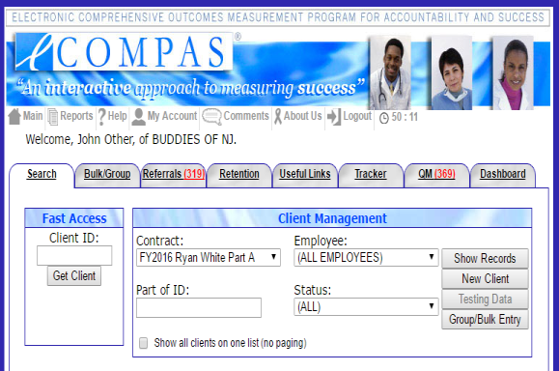

Slide 52
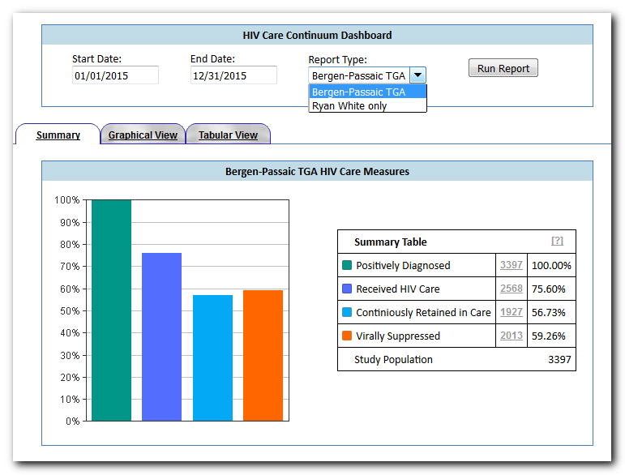

Slide 53
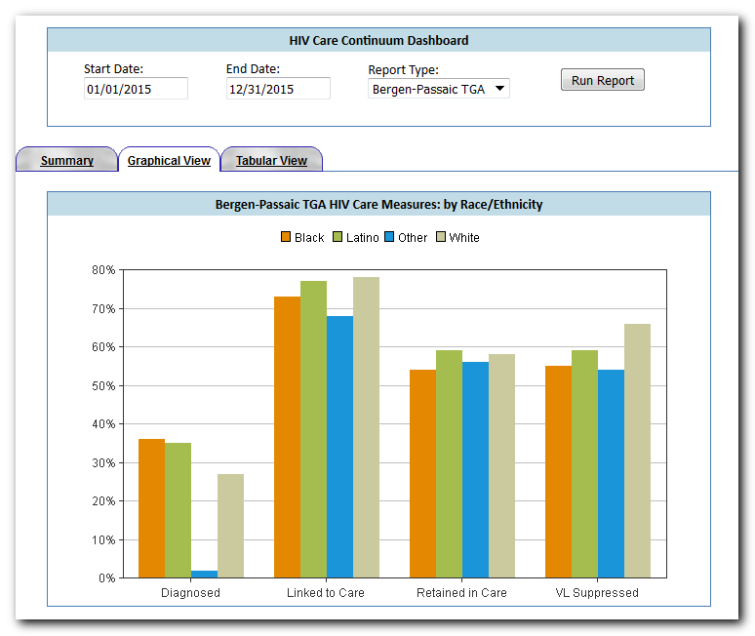

Slide 54
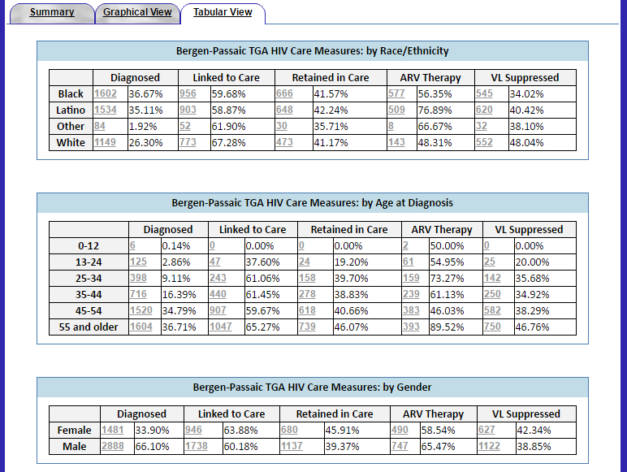
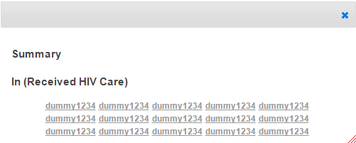

Slide 55
Benefits
Truly innovative tool to help providers assess the continuum
Data available from all the testing sites within the region and outside the Part A network
HIV Positive clients identified in and outside Part A network
Date of first medical visit available to determine if clients are in care anywhere within the State
Medication data available to determine ART in RWHAP network
Viral load data will help identify clients who are Virally Suppressed

Slide 56
Barriers and mitigation
Challenges
Mitigation
Success
SPNS team was able to get a head start and were able to develop prototype of the dashboard.
First prototype built with current summarized data
Prototype demonstrated to Providers and Consumers at the Quarterly Quality Management Meeting on 4/18/2016.
Valuable feedback from the QM meeting gathered and reviewed by SPNS team.
2015 aggregate data harvested and prototype update
Data Transfer through eHIE (expanded Health Information Exchange)
Specifications
Data consistencies across disparate databases at the small area
Draft specifications built based on samples from NJ/NY Care Continuum models and Continuum of HIV Care Guidance for Local Analyses
Mock-ups built based on the draft specs
Functional prototype built with aggregate data in parallel while eHIE is in progress
Data analysis and design

Slide 57
Current Status and Next Steps
Demonstrated the prototype to consumers and providers at the Quarterly Quality Management meeting on 4/18/2016
Demonstrated the prototype to consumers and providers at Integrated Prevention and Care Planning Workshop on 8/17/2016
Valuable discussion and feedback collected
Next steps: Enhancements to the prototype
Interactive dashboard

Slide 58
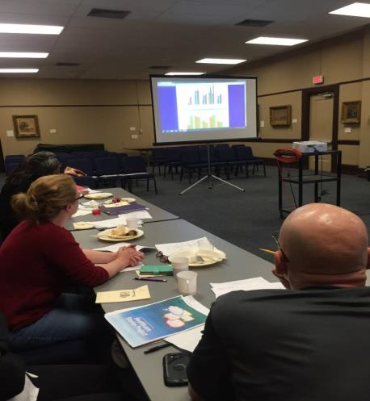
Bergen-Passaic
Quality Management Team
Studying the HIV Care Continuum

Slide 59
Feedback from Consumers and Providers

Slide 60
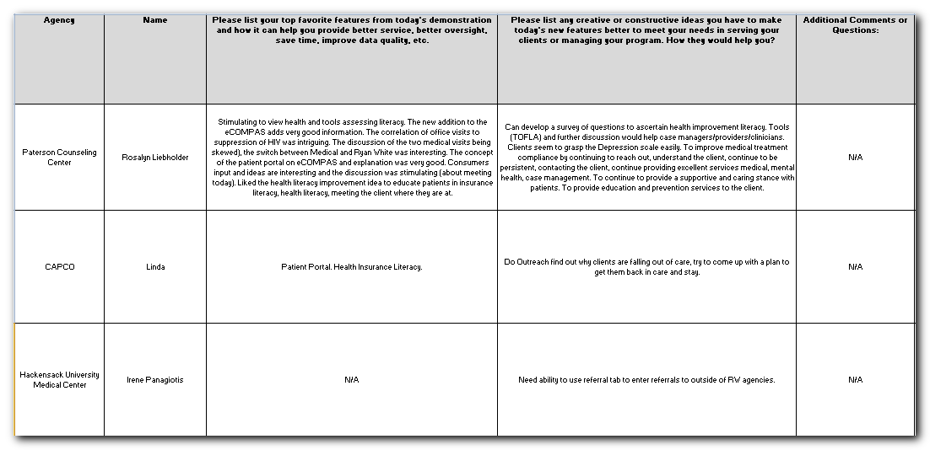
Feedback from Consumers and Providers

Slide 61
Quality Management Team 2016

Slide 62
Thank You!

Slide 63
Contact Us
Milagros Izquierdo, Director, Bergen-Passaic TGA Ryan White Program
mizquierdo@patersonnj.gov
Jesse Thomas, Project Director, RDE Systems LLC
jesse@rdesystems.com
Patricia H. Virga, Ph.D, Vice President, New Solutions, Inc.
pvirga@newsolutionsinc.com
Collaborator: Dr. Peter Gordon, MD, Medical Director Comprehensive Health Program, NY Presbyterian
pgg2@cumc.columbia.edu
41

Slide 64
Thank you Mayor Jose “joey” Torres, Chief Elected Official Ryan White Program City of Paterson

