Slide 1
Using Multilingual, Audio-Assisted Web & Mobile Evidence-Based Needs Assessments to Plan, Fund and Actuate Care Services
Michael McNeill, Health Care Analyst/Administrative Services Coordinator, Wake County NC Human Services
Katie Herting, Ryan White Part B Program Manager, Iowa Department of Public Health
Jonathan Hanft, Ryan White Program Manager, Hennepin County MN Human Services & Public Health Department
Jesse Thomas, RDE System Support Group, LLC
Notes:
Required slide. Please complete

Slide 2
Disclosures
Wake County NC Human Services, Iowa Department of Public Health and Hennepin County MN Human Services & Public Health Department have no financial interest to disclose.
Jesse Thomas works as Project Director for RDE System Support Group, LLC.
This continuing education activity is managed and accredited by Professional Education Services Group in cooperation with HSRA and LRG. PESG, HSRA, LRG and all accrediting organization do not support or endorse any product or service mentioned in this activity.
PESG, HRSA, and LRG staff has no financial interest to disclose.
Notes:
Required slide. Please complete section under Presenter

Slide 3
Introductions
Jesse Thomas, Project Director, RDE Systems
Serving public health for over 18 years, HIV/AIDS programs 12+ years (HRSA, CDC, HUD, NIH)
RDE Systems: First PLWHA IT company to do online consumer needs assessment surveys.
Technical Manager for over 12 HRSA Special Projects of National Significance

Slide 4
Learning Objectives
At the conclusion of this activity, the participant will be able to:
Recognize how a paradigm of improved data collection strengthens grant applications, provides answers to community planning bodies, illuminates counterintuitive insights important for the description of barriers and helps positively to influence health planning and policy recommendations
Describe how to adopt and adapt strategies and tools to deliver web-based technology to the community and planning bodies while overcoming digital divides and perceptions of digital divides.
Identify, analyze and evaluate the challenges and benefits of an innovative program for mobile / web-based, audio-assisted, multilingual Needs Assessments and Client Satisfaction Surveys.
Notes:
Required slide. Please complete

Slide 5
Obtaining CME/CE Credit
If you would like to receive continuing education credit for this activity, please visit:
http://ryanwhite.cds.pesgce.com
Notes:
Required slide.

Slide 6
National HIV/AIDS Strategy
Goals:
Reducing new HIV infections
Increasing access to care and improving health outcomes for people living with HIV
Reducing HIV related disparities
(Implementation Plan: Achieving a more coordinated National response to the HIV/AIDS epidemic in the U.S.)

Slide 7
How Do We Know What Services to Provide?
Evidence-based planning for HIV prevention and care services begins with:
DATA-DRIVEN NEEDS ASSESSMENT
The “Justification of Need” is included in every grant application that you write.
Developing an effective needs assessment process is vital to organizational sustainability and delivering high quality, effective programs.

Slide 8
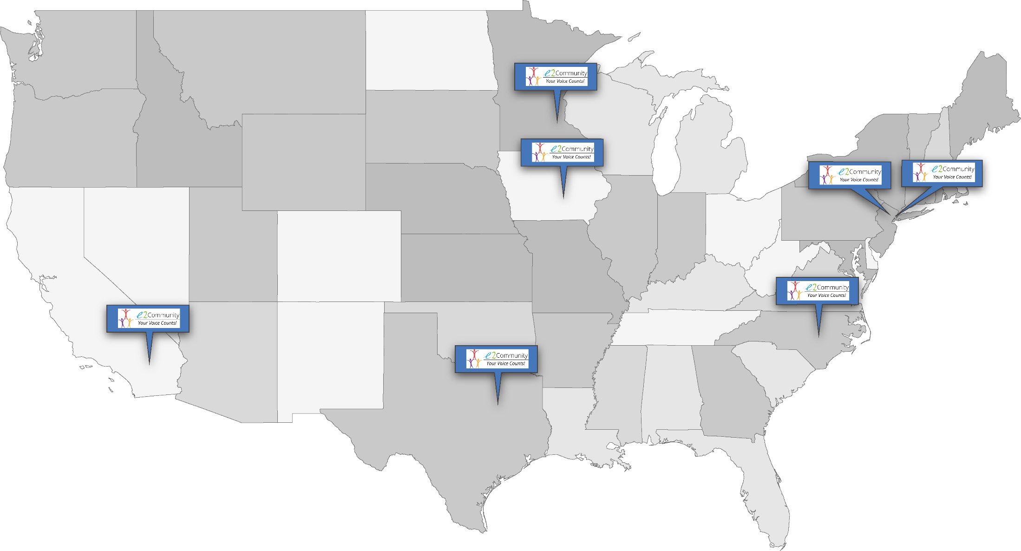
National Context

Slide 9
Over 8,000 Total Consumers

Slide 10
Covering Urban, Suburban, and Rural Regions.

Slide 11
Survey Complexity: Over 8,000 Q & A Fields

Slide 12
Over 4.8 Million Data Points

Slide 13
Diversity of Size of Regions: PLHWA

Slide 14
Over $40,000 in Client Incentives Distributed

Slide 15
Over 15,000 Staff Hours Saved!

Slide 16
Traditional Needs Assessment Process

Slide 17
Problem Statement
Too much time spent managing paperwork
Delay from data collection to action
Validating surveys a challenge
Too costly and inefficient
Paper reports are not interactive
Questions people have about the data result in health planners having to manually re-analyze the data

Slide 18
Our Vision

Slide 19
BEFORE: Paper Interview Effort: Survey Wave & Reporting

Slide 20
AFTER: Much less effort + quicker survey cycles with Web (e2Community)
Real-time
Reporting

Slide 21
Health Planning: A Tale of Two Eras
Notes:
Month 1: Contracting
Month 2-5:
writing survey instrument
e2: adapting instrument for web-based tool, spec negotiation
paper: coding
Month 6:
Translation, Initial outreach
paper: team logistics for outreach effort, printing, shipping of printed materials
e2: data entry, prototype launch, translation, audio recording, quality assurance
Month 7,8,9,:
active survey period, continuing outreach
paper: active surveying, massive effort required.
e2: no active effort required, review reports at month 8
Month 10:
end survey period
paper: cease surveying activities, digitize data
e2: may let survey wave continue, instantly read visual reports, analyze reports
Month 11:
paper: analyze reports
e2: continue wave or restart at reduced effort
Month 12:
paper: start over again completely

Slide 22
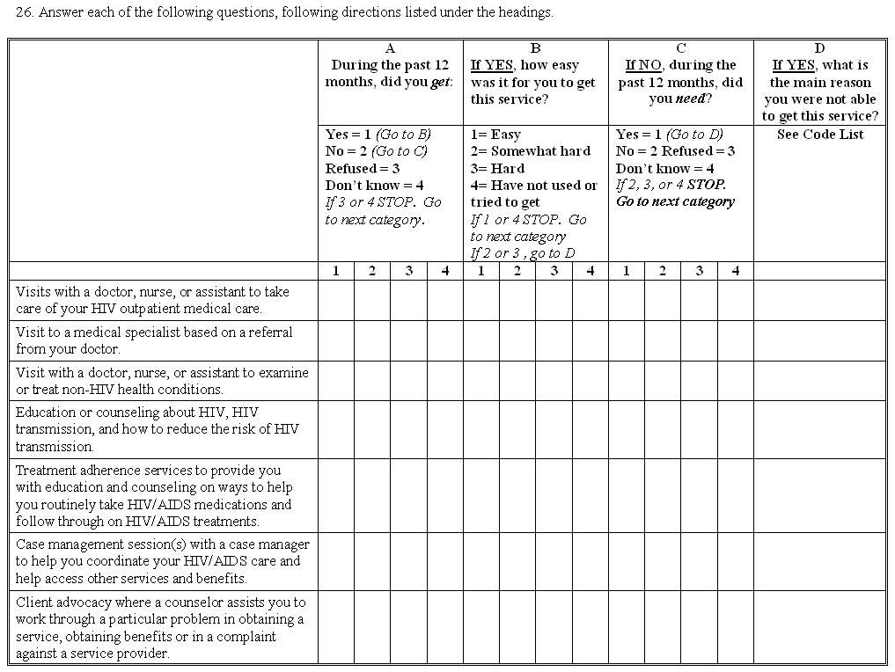
The Old Way

Slide 23
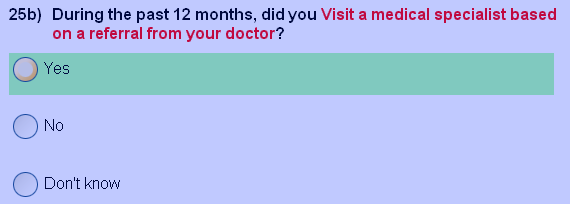
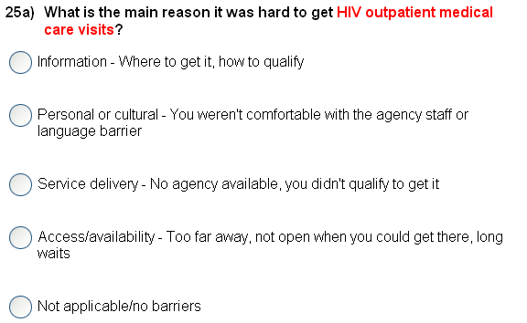
Next
Question
Next
Question
The New Way The System does all the work behind the scenes.

Slide 24
New York City

Slide 25
Case Study: NYC Client Satisfaction & IRB Surveys
Client Record Linking: “Survey IDs could be linked to client information in eSHARE and Registry system, allowing for analysis of service patterns and clinical outcomes, and also fewer demographic questions needed to be asked.”
Proactive TA: “Because of the way survey IDs were set up, even for anonymous surveys, we could figure out which service category and agency a person was being surveyed about. This allowed us to look at the types of responses received by service category and agency and to use that information to provide technical assistance to agencies regarding particular problem areas, and to identify particular facilitators and barriers to receiving services by agency and service category.”
Real-time Analysis: “Electronic extract of survey data made real-time analysis of survey data possible and could be used to regularly track survey’s progress and any survey issues.”
Better Consumer Experience: “We have found, anecdotally, that many clients enjoy the experience of taking the survey as well as the ability to provide feedback on different aspects of the Care Coordination program. Clients have reported that the survey platform is easy to use, with many clients having taken it on smartphones, tablets, and computers.”

Slide 26
More qualitative data with web (e2)
22% improvement over paper surveys.

Slide 28
Summary of Three Regions
Number of consumers surveyed: 2,041
Languages used: English, Spanish
Number of municipalities covered: 1,956
Number of Q&A fields in real-time: 3,641
Number of staff hours saved: 4,370

Slide 29
Hennepin County / Minnesota’s Comprehensive Needs Assessment Web-Audio Surveys

Slide 30
Vision
Have a fully Web-Based system that was multi-lingual and audio-assisted self interview (ACASI) with no software to install or manage.
Save paper and the time spent managing it
Allow consumers to self-interview at comfort of home or provider site
Utilize netbooks & mobile devices for efficient outreach efforts in collecting completed surveys
Realize cost-savings

Slide 31
Vision
Have real-time access to data
Use real-time access to monitor gaps in data collection so we can target outreach efforts to ensure a representative sample
Allow consumers redeem incentives through an incentive code automatically generated at survey completion
Allow incentives to be distributed in person, or mailed to consumer.
Utilize Visual Analytics to make data more actionable in real-time for better planning, decision making, and grant applications.

Slide 32
Vision Accomplished?
Yes!
With some unanticipated benefits too…

Slide 33
How did we do it?
Attended the 2008 HRSA AGM Meeting and saw a presentation on “Innovative Planning Bodies Technology” presented by the Bergen-Passaic TGA, City of Paterson
Collaborated with the Bergen-Passaic TGA on revised needs assessment instrument.
Contracted with RDE Systems, LLC makers of eCOMPAS and the e2 Community Platform
Utilized the e2 Comprehensive Needs Assessment Module that Paterson New Jersey pioneered and presented
RDE adapted software to Minnesota’s unique needs and vision.

Slide 34
How did we do it?
RDE walked the Minnesota team through the process.
RDE produced a pilot site for us to pilot with a focus group of consumers, the planning council, and staff.
Revisions were made to the system.
With minimal training, our staff completed Spanish translations and voice-overs with no special equipment using the systems web-based admin module.
System was launched smoothly

Slide 35
Social Marketing

Slide 36
Is a web-based survey a barrier?

Slide 37
Double the Response Rate

Slide 38
Quarter the Time Per Response
8% Q&A
Field Increase
72% Response
Time Decrease

Slide 39
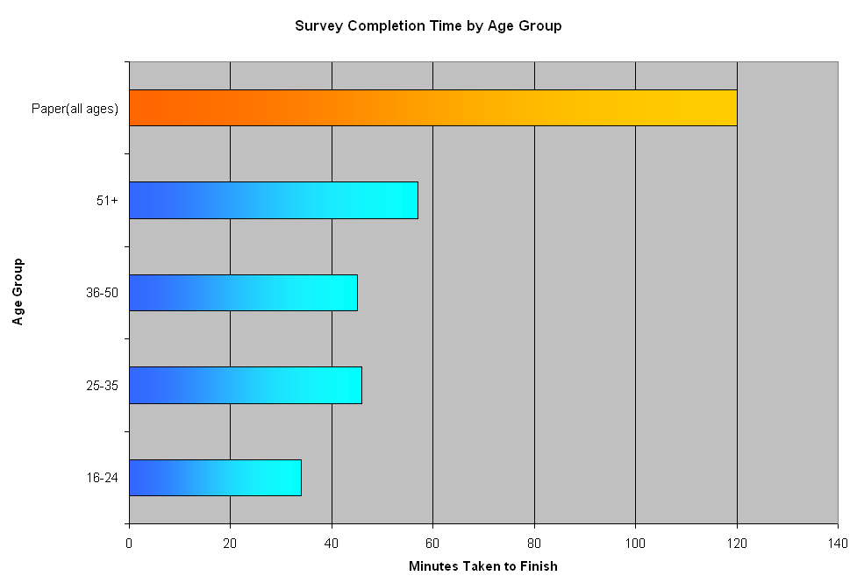
Compared to 2003, Big Difference!

Slide 40
Innovative Use of Inexpensive Netbooks

Slide 41
Before Netbooks and eCOMPAS
After
Netbooks and eCOMPAS
2010: Majority of respondents (69%) did so from a private/public computer.
The remaining 21% participated in a session led by one of six volunteer consumer ambassadors
2003: Survey required
6 interviewers to conduct
face-to-face interviews

Slide 42
Unanticipated Benefit:
Needed to do translation only once on the web.
Instead of needing a translator for each consumer who needed it.

Slide 43
MHSPC Cost Savings Analysis
> 64% Cost Savings Using
Web (e2Community)

Slide 44
Case Study: African-Born Population
Minnesota has 9th largest African-born population of all states.
EPI 2003: 263 / 4331, or 6% of total population.
Language barriers:
Many different languages spoken.
Interpreters must come from the communities PLWHA do.
Stigma barriers:
African-born PLWHA are often highly stigmatized in their communities.
If consumers assume interpreters will stigmatize them, why would they take the survey?

Slide 45
How are Interpreters Seen by Clients?

Slide 46
Case Study: African-Born Population

Slide 47
Case Study: African-Born Population
Results: response rate for African-born population higher in e2Community than with paper-based interviews.
Increase in response rate between first and second e2Community wave.
Recipient can monitor response rate per agency with on-board instant reporting.
Address and adjust outreach in poorly-performing agencies during the survey wave.

Slide 48
Case Study: Stigma Affecting Response Rate
Stigma issue not as pronounced with e2Commnity.
No interpreter.
Can take survey from comfort of own home.
Idea for targeted outreach: translate survey to needed languages and use e2Community audio assisted survey!

Slide 49
Lessons Learned
Networking and collaborating with colleagues is a rewarding experience.
User friendly systems make the world of difference and the e2 Web Survey system is very easy to use.
It’s important to work with a technology partner who can work well with others and who are “user friendly” and not too techie for us.
Target your outreach to hard to reach populations early on to increase success.
Think outside the box!

Slide 50
Des Moines, Iowa

Slide 51
Previous Survey Waves
All previous survey waves were done either in paper or with a non-specialized surveying tool, e.g. Survey Monkey.
Paper-based surveys were mailed to clients, no need for interviewers.
Removing paper-survey digitization step still constituted significant time savings.
Typically 120 hours of data entry required.
Process is error-prone, causing further head-aches.

Slide 52
History
2005 – Paper survey
Original survey developed
Managed by program manager
Hired consulting agency to enter raw data – took 4 weeks to receive
Data analysis conducted in Excel by program staff
2011 – Paper and online survey
Managed by temp
Paper survey data entered into Survey Monkey (110 hours)
Paper and online results displayed in Survey Monkey (separately)
Other data analysis conducted in Excel by contractor
2008 – Paper survey
Managed by intern/temp
Hired consulting agency to enter raw data – took 4 weeks to receive
Data analysis conducted in Excel by contractor
2016 – Online survey
Managed by RDE Systems and temp
Data available in real-time
Data analyses conducted by RDE Systems
Other data analysis conducted by program staff
Notes:
110 hours = 219 paper surveys entered into Survey Monkey x 30 min/survey
Bad temps → poorly managed surveys

Slide 53
Areas of Work
Survey development
Survey pilot
Correspondence with contractors
Survey preparation and distribution
Data collection
Incentive tracking and distribution
Data analysis
Survey report
Notes:
Big differences in survey management between paper and online surveys highlighted in red
Survey development
Draft survey
Survey pilot
Correspondence with contractors
Provide rational for the survey and directions about distributing the survey
Survey preparation and distribution
Paper survey: print surveys, translate paper document, send materials to contractors, mail surveys
Online survey: print survey letters, translate online survey through RDE systems portal, send materials to contractors, mail survey letters
Data collection
Paper survey: have to receive surveys in the mail from participants, had to hire people to enter the data
Paper/online survey: had to enter the paper survey data into Survey Monkey
Online survey: responses received in real time, data displayed online and available to review in real time
Incentive tracking and distribution
Develop system for tracking incentives
Paper survey: contractors sent incentives to participants upon receiving completed surveys
Online survey: participants called us to request incentive upon completing survey/receiving online instructions to receive their incentive
Data analysis
Paper survey: raw data analyzed in Excel
Paper/online survey: data displayed in Survey Monkey, further analyses conducted in excel with raw data
Online survey: data displayed in RDE system’s online portal with analytics capabilities, analytics specifications developed before survey launch (further raw data analyzed in Excel because we didn’t think to ask for it originally), data crossed in visual analytics portal
Survey report
Able to be disseminated sooner with online survey due to less staff time spent on and delays in receiving data/conducting analyses

Slide 54
Outreach Strategy
Agencies with on-site outreach & resources have heavy utilization of those resources.
Around 50% utilization rate.
PCs & tablets.
Personal assistance.
Etc.
Otherwise, respondents typically used their own equipment to access survey tool.
85% utilization rate of own personal PC, tablet, or mobile phone.

Slide 55
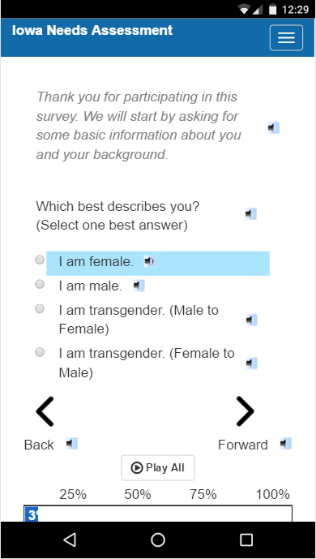
Accessibility features include:
Mobile & tablet compatibility!
Multi-language capability.
Audio playback for all texts.
Mobile compatible.
Fully translatable.
Survey progress saving.
Notes:
Survey progress saving: won’t lose your survey if your internet connection is poor.

Slide 56
Strong data-backed conclusions made mid-survey wave!

Slide 57
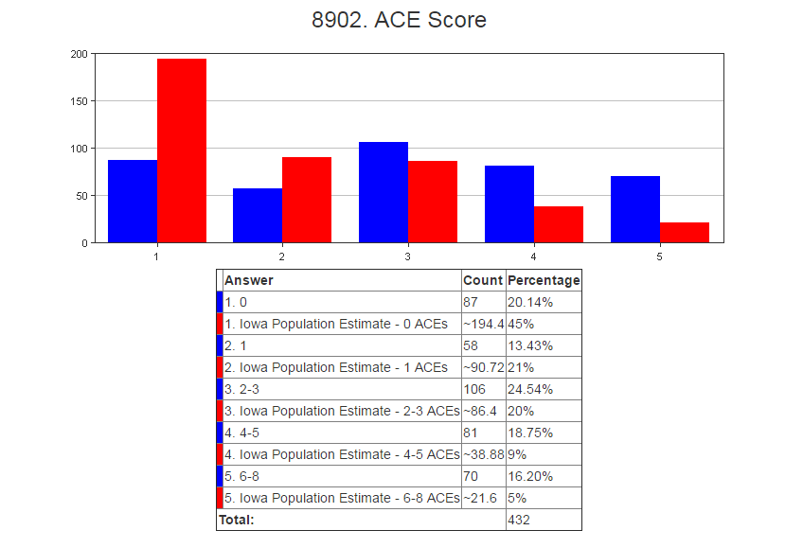
Data Analysis: Visual Analytics
Notes:
Real-time data/results viewed in RDE System’s visual analytics portal
Adverse Childhood Experiences (ACEs):
Evidence suggests that a strong relationship exists between childhood trauma and poor physical, social, and mental health outcomes decades later. The Adverse Childhood Experiences Study was the first to examine the relationship between adverse childhood experiences (ACEs) and a range of long-term health and social outcomes. The study supports that as the number of ACEs increase, so does the risk of developing heart disease, depression, substance use disorders, intimate partner violence, acquisition of sexually transmitted diseases, and early death. This is because frequent and prolonged activation of the body’s stress response during childhood disrupts brain development, causes social, emotional, and cognitive impairment, and ultimately the adoption of health-risk behaviors, disease, disability, and social problems.
ACE data was collected in the 2016 Iowa HIV Consumer Needs Assessment survey in order to determine the impact of childhood trauma on people living with HIV compared to that of Iowa’s general population. ACE’s are calculated based on an 11-question survey. RDE Systems calculated the ACE scores using the 11 survey questions on the back end so that all we see is the prevalence of ACEs and not the raw data.
The results were compared to the ACE data collected in the 2012 Iowa Behavioral Risk Factor Surveillance System. The results suggest that experiences of childhood trauma is much higher amongst Iowans living with HIV versus the general population:

Slide 58
Data Analysis: Mid-Survey Results
Notes:
Mid-survey results analyzed in comparison to state-wide Iowa data; results very similar to final results (see next slide)
Viewing results mid-survey allowed us to incorporate the ground-breaking insight into our Statewide Plan

Slide 59
Data Analysis: Final Results

Slide 60
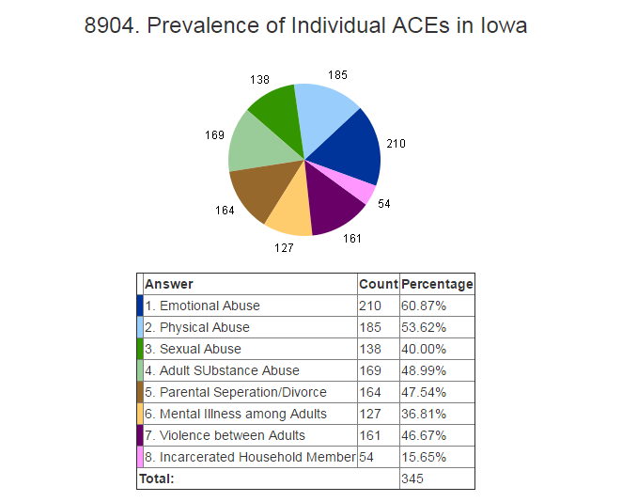
Data Analysis: Visual Analytics
Notes:
Real-time data/results viewed in RDE System’s visual analytics portal
Adverse Childhood Experiences (ACEs):
Evidence suggests that a strong relationship exists between childhood trauma and poor physical, social, and mental health outcomes decades later. The Adverse Childhood Experiences Study was the first to examine the relationship between adverse childhood experiences (ACEs) and a range of long-term health and social outcomes. The study supports that as the number of ACEs increase, so does the risk of developing heart disease, depression, substance use disorders, intimate partner violence, acquisition of sexually transmitted diseases, and early death. This is because frequent and prolonged activation of the body’s stress response during childhood disrupts brain development, causes social, emotional, and cognitive impairment, and ultimately the adoption of health-risk behaviors, disease, disability, and social problems.
ACE prevalence was collected in the 2016 Iowa HIV Consumer Needs Assessment survey in order to determine the impact of childhood trauma on people living with HIV compared to that of Iowa’s general population. ACE’s are calculated based on an 11-question survey. RDE Systems calculated the ACE scores using the 11 survey questions on the back end so that all we see is the prevalence of ACEs and not the raw data.

Slide 61
Data Analysis: Mid-Survey Results
Notes:
Mid-survey results analyzed in comparison to state-wide Iowa data; results very similar to final results (see next slide)
Viewing results mid-survey allowed us to incorporate the ground-breaking insight into our Statewide Plan

Slide 62
Data Analysis: Final Results

Slide 63
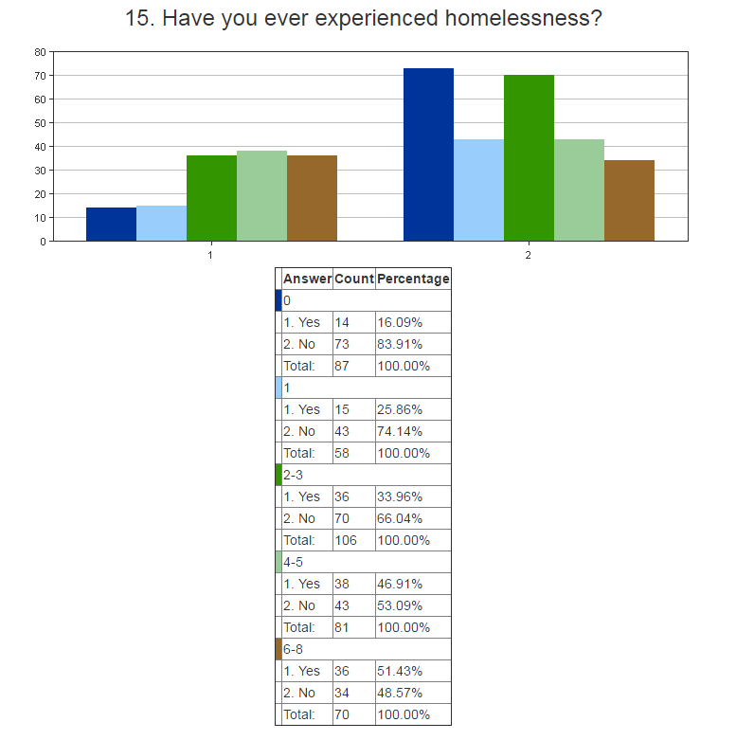
Data Analysis: Crossing Data
Notes:
This is homelessness broken down by ACE score. PLWHA who had experienced homelessness were likely to have a higher ACE score.

Slide 64
Further Data Analysis: Final Results

Slide 65
Conclusion about Online Surveys
Save staff time
Do not rely on competence of staff
Reduce burden for clients
Allow for:
Real-time analysis of data
Greater in-depth analysis of data
Faster dissemination of data

Slide 66
Lessons Learned
Early in the process:
Consider alterations you will need to make to survey instrument for online use early
Design reporting instruments to dig down to the information you need.
Factor contract procurement into timetable.
Review real-time analytics to adjust population outreach effort.

Slide 67
Region 6, North Carolina

Slide 68
Region 6 Process: Network Needs
11 counties in the northern-central part of North Carolina and includes Raleigh, Durham and Chapel Hill.
State’s highest concentration of PLWHA at more than 22% AND is home to the highest number of HIV Providers.
Medical destination for a large number of PLWHA who come into the region for care both from across N.C. as well as from other parts of the U.S.

Slide 69
Region 6 Process: Network Needs
Network needed a mechanism for being able to gather data on a large scale, across multiple counties and with multiple providers.
Network needed a mechanism for being able to gather data with minimal staff time/involvement. Involving survey facilitators was estimated to take more than 5 months to collect our target survey collection of 250 surveys representing clients of all counties, of all service providers, of all socio-economic backgrounds, etc.
Factoring in the need for bi-lingual staff only added to the length of time necessary to gather a sufficient amount of data

Slide 70
Region 6 Process: Network Needs
Spanish surveys would also mean Spanish language results. The network would need someone to translate the results.
The network would need a system into which the surveys could be entered and then analyzed ---- translation, the network needed both a database as well as data entry time/staff
More than 1500 projected staff hours required JUST to get the surveys collected, translated (if necessary) and into a system for analysis.

Slide 71
Region 6 Problem Statement
Immediate problem – the needs assessment would be required to be “maintain[ed], updat[ed] and utiliz[ed]”
Process will need to be repeated, requiring:
Another extended period of staff time.
All the costs associated with the first survey wave.
Re-writing and re-translating the survey instrument.
Etc.
Network needed something the could be ongoing without reintroducing those costs.

Slide 72
Region 6 Process: A History
Network reviewed survey – too long.
Trimmed to 76 questions – still considered too long – no agreement on what to cut.
Survey finalized / everyone still agreeing that it was too long.
Survey launched survey in October 2012 with a goal of 250 surveys (the next largest regional survey collection at that time was approximately 125).

Slide 73
Region 6 : Initial Fears in using technology / online system
Clients do not have access to the internet/computers
Older clients do not understand how to use computers
Clients have low literacy rates and will not be able to read/take an online survey without someone there to assist them – where is the savings in staff time?
Any online system will still need to be bi-lingual and interpret Spanish language results.
Clients will not trust the program
The survey (at more than 70 questions) is too long – clients will not complete it.
Installing computer software on multiple computers at multiple locations would take too long, involve too many I.T. Departments and probably would not be allowed at all locations.
Clients will not complete survey without an incentive.

Slide 74
Region 6 Process: Realities of using on-line system (specifically eCompas)
Clients do not have access to the internet/computers
We exceeded every other region within the 1st month. We met our goal of 250 within the first 60 days. . In total, nearly 400 clients completed the survey in the first 90 days… 180% more than our goal!
Older clients do not understand how to use computers
68.7% of those completing the survey were 40 and older. 36.7% were 50 and older. The oldest was over 80.
Clients have low literacy rates and will not be able to read/take an online survey without someone to assist them – where is the savings in staff time?
System read aloud to the clients. Limited need for assistance. Savings in staff time ABUNDANT!

Slide 75
Realities of using on-line system (specifically eCompas)
Any online system will still need to be bi-lingual and interpret Spanish language results.
The questions and answers appear and are read in both Spanish and English languages.
Clients will not trust the program.
There were no reported client fears.

Slide 76
Realities of using on-line system (specifically eCompas)
The survey is too long – clients will not complete it.
82.1% of clients beginning the survey finished it.
Median time needed to complete surveys: 21 minutes.
Utilized a collaborative process in creating the survey which actuated in all programs taking an active part in promoting it to their clients: each program would have components of the result that pertained specifically to them
Installing computer software is going to be a problem.
Web-based system. Nothing to install.

Slide 77
Realities of using on-line system (specifically eCompas)
Clients will not complete the survey without an incentive.
Clients given opportunity to accept or decline $10 incentive.
11% of respondents initially declined incentive.
This later grew to 15%.

Slide 78
Region 6 Process: How we did it
RDE walked us through the process – created our survey online, walked us through the recording process (for the audio feature of the survey).
RDE produced a pilot site for us to pilot with a focus group of consumers, the network, and staff.
Revisions were made to the system.
Coordinated with two regional individuals to record the questions/answers --- one recorded them in English, one in Spanish.
Added our own spin by recording “welcome videos” utilizing individuals known locally and trusted by anticipated survey participants.
System was launched smoothly

Slide 79
Social Marketing
Created Postcards on which clients could record their survey completion code, mail in, and then have their incentive mailed to them.
Postcards were created in both English and Spanish
Postcards were given to each network provider along with Raleigh Infectious Diseases, prevention and testing programs, Gay and Lesbian Center in Raleigh, Raleigh nightclubs/bars (to help us reach the “positively unaware”)
Actively promoted by each of our programs and program areas (all clinics and service agencies had survey questions that pertained to their activities and thus had vested interests in learning the responses).

Slide 80
Results

Slide 81
Over 1,100 hours staff time saved! (making field workers’ feet happier too!) _

Slide 82
Results

Slide 83
Results
Information is no longer anecdotal. Many of our beliefs were upheld while many were surprising.
Example: Transportation
Belief:
Clients need transportation services especially in the rural areas.

Slide 84
Results
Example: Transportation
Results (confirmation): Clients indeed identified Transportation as the 8th most important service in the treatment of HIV Within rural counties, the farther away clients were from a clinic, the greater the concentration of those indicating that transportation was important.
Results (surprising): While rural residents showed a greater need for transportation the farther they lived from an HIV clinic, urban residents were much more likely to identify the service as important. Urban residents under the age of 24 were the most likely to state that the service was needed/important. (other transportation data validated results)

Slide 85
Updates
We have kept our survey system “live” since it’s launch. For our 2015 survey, more than 600 clients completed within our review period without any considerable effort on our part.
We built in client satisfaction questions that have been pulled and reported to our Part B and Part C Recipient every 6 months.
We have made significant changes to our budgets and to our delivery system based upon these questions (i.e. increased funding in dental and transportation while decreasing less needed services such as linguistic services

Slide 86
Updates to Budget
Dental line increased by 123%.
Medical transportation line increased by 45%.
Number of medical transportation services provided increased by 1000s.
Cost of medical transportation services dropped dramatically.
Expanded medical transportation options to clients.
Utilized 100% of transportation funds after 2013!

Slide 87
Updates
The difference in the amount of time it takes to complete the survey for younger and older participants is about 12-17 minutes more for older clients. This was initially believed to be because they were older and less accustomed to the technology.
This may be partially true. However, in looking at the results, older clients tended to be positive longer (excluding those with perinatal infection) than their younger counterparts.
As such, more of the questions applied to them (i.e. the skip-logic did not skip as many questions as most of the questions in fact pertained to them given their life experiences).
Factoring in the average time per question asked, the amount of time per question was only slightly higher than their younger counterparts. (it appears to be about 5% higher).

Slide 88
Lessons Learned
Main objective lesson: involve all aspects of program in planning.
Including all provider input in survey tool creation led to better coverage.
Get everyone on board early.
A fully inclusive process takes extra time but the results are worth it.
Pre-plan for survey tool translation and audio recording.

Slide 89
Q & A

Slide 90
Wrap Up

Slide 91
196,000 pages of paper saved
and counting…
Thanks!
Thanks!

Slide 92
Replication and expansion
Client Satisfaction
Rolling Needs Assessment
Tailored Action Buttons
Statistical Reporting
Online, Interactive Resource Guide

Slide 93
Feedback on e2 approach
“Survey Monkey is an ok tool but only has canned reporting and is not helpful for low-literacy outreach. E2Community has customizable analytics which are very helpful, and the audio playback feature saves many hours of staff time. ”
– Needs Assessment Consultant
“Although many providers seemed to be hesitant and wary of an electronic tool at first, many of them finally opened up to the idea and saw how simple the process actually was. I also anticipate that they will be glad to get reports on client satisfaction back to them sooner than they would have with a paper survey.” – Field Research Assistant

Slide 94
Feedback on e2 approach
“We do want to commend you guys on the ease of use of your system. This part has been so remarkably easy! Thanks for making this as painless as possible!”
– RW Data Manager
“We are really starting to see the advantages of having an electronic tool for this survey process.” – Research & Evaluation Director

Slide 95
Practical Lessons for Replication
Find a few key champions on the planning body, ricipient, and quality team.
Utilize a web-based architecture to minimize management and maintenance headaches and costs.
Choose a systems partner and consultant who operates on a human-centered approach (not technical approach) and has experience with surveying special populations.
Just do it. Don’t be paralyzed with logistics. Evolve protocol and system based on experience.

Slide 96
Lesson: How did we accomplish this?
One bite at a time.

Slide 97
Thank you for your time!

Slide 98
Jesse Thomas Jesse@rde.org Jonathan Hanft Jonathan.Hanft@hennepin.us Katie Herting Katie.Herting@idph.iowa.gov Michael McNeill Michael.McNeill@wakegov.com

